Slide 1
Phoenix Training Completing the IEP 2022‐2023
This is one of 2 sections for Phoenix IEP Chair Training.
This section covers completing the IEP including all forms and screens.
The other section, Navigating Phoenix, covers basic navigation, the reevaluation process, completing IEP Amendment and IEP Correction events, progress reports, changing providers, teacher reports, student reports and Phoenix Supports.
Some of this is covered during IEP Chair training but there is much more here. Use the bookmarks to navigate to the page you wish to view.

Slide 2
Notification of Meeting
‐ Annual IEP
The Notification of Meeting must be completed, saved, and stored for the associated event, in this case the Annual IEP, to lock.
The NOM must be printed and provided to the parent at least 10 days prior to the Meeting Date unless the parent has waived the 10 days.
It is not enough to notify the parent of the date, time and location verbally or through email. They must receive a copy of the NOM which includes other information the district is legally required to provide.

Slide 3
Notification of Meeting – Annual IEP
Notification of Meeting is linked to Annual IEP
Click the event name to open NOM
The open envelope icon indicates no notices have been created and stored
Notification of Meeting
The Notification of Meeting (NOM) is a separate event associated with the main event. Not all events have an NOM (for example: Reevaluation Decision, Disciplinary Documentation, IEP Amendment, and IEP Correction)
It is always linked to the "parent" event – it is linked here to the Annual IEP
Stays linked after the event (IEP) is locked
Should be completed before the IEP is opened or the Plan Dates will have to be edited when the IEP is opened
Icons on Scheduled Event panel:
Edit (aka the pencil): Used throughout the program to change/edit something
On the Scheduled Events panel it opens the Schedule Meeting Window
Can not be used to change the Scheduled (Meeting) Date for the Annual IEP (or other events with an associated NOM) – the Scheduled Date is entered on the NOM form
Can be used to change the scheduled date of an event that does not have a Notification of Meeting attached such as a Reevaluation Decision
Can be used to change Primary Staff assigned to the meeting – the meeting will then appear on your My Meetings Calendar
For events with a Notification of Meeting, this change is made using the Edit icon for the NOM, not the event itself.
Envelope: indicates the number of NOMs that have been created and stored. The envelope is white until an NOM is stored then it is black filled. At least one NOM must be "stored" to lock the associated event.

Slide 4
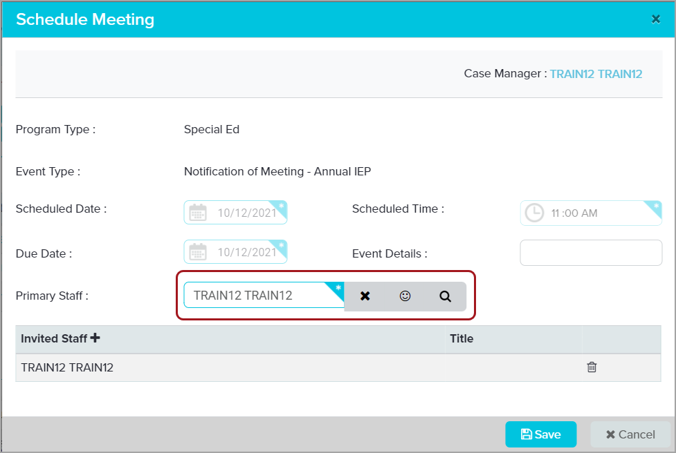
Schedule Meeting Window
Used to change Primary Staff of event
Can add "Invited Staff"
Event appears on their "My Meetings" calendar
Can be used to change Scheduled Date in some events
Schedule Meeting Window
The Schedule Meeting window opens when the "Edit" icon (the pencil) is selected.
The window can be used to change the Primary Staff for the event. The event will then appear on the user’s My Meetings calendar on the Dashboard when it is due within 30 days.
Can add others as "Invited Staff" for the event. The event will appear on their My Meetings calendar.
The Scheduled Date cannot be edited for an event with a Notification of Meeting. The date is entered and updated on the Notification of Meeting form.
The Scheduled Date can be edited on events without a Notification of Meeting such as the Reevaluation Decision (covered later). An event cannot be locked in Phoenix prior to the Scheduled Date so it is necessary to edit the date if it is in the future. Click in the date field to display the calendar then select the date.
The Due Date is editable in some events but should only be changed if you created the event. You should never change the Due Date for an IEP or Reevaluation event.

Slide 5
NOM – Event Overview
The Overview shows
Event Sections
List of forms in each Event Section
Required forms – indicated by star icon
Buttons at bottom
Event Overview
After opening an event, the Event Overview displays The Event Overview
Displays the Forms List on the left side of the screen
On right side is a list of forms available in each Event Section
Not all forms display on the Overview when the IEP is opened for the first time. Some forms are “hidden” until the user creates them.
Series of buttons across the bottom – Explained on next slide
To open a form, click the name of the form on either the Forms List panel or on the Overview list

Slide 6
Overview Icons – NOM Events
A
B
C
D
E
Icons appear at the bottom of the Overview
Back to Events: closes the event and returns you to the Events page
Invitation Record: Includes all "stored" NOM and Record of Attempt forms (only on NOM events)
Reload Event Data: Refreshes form data
Create/Store Invite: Creates a PDF of the NOM and Record of Attempts and Stores them in the Invitation Record (NOM events)
Validation Check: Checks that all required forms and fields have been completed – checks for program compliance, not DESE compliance.
Links and Icons available across the bottom of the Event Overview of the NOM event:
Back to Events: closes the event and returns you to the Events page
Invitation Record: Includes the PDF of all "stored" NOM and Record of Attempt forms. This is where copies of previously completed NOM forms can be viewed and printed.
Reload Event Data: Refreshes form data
Create/Store Invite: Creates a PDF of the NOM and Record of Attempts and Stores them in the Invitation Record
Validation Check: Checks that all required forms and fields have been completed – checks for program compliance, not DESE compliance. There are frequently times that Phoenix will allow an event to be locked because it meets program compliance even if it doesn’t meet DESE compliance. Although many rules are included in Phoenix to assist with compliance, it is impossible to program for all possibilities. This is the reason it is critical to proofread before locking.

Slide 7
Notice of Meeting
To view form, click Notice of Meeting on Forms List panel or on the Form Name list
Notifice of Meeting
Open the form by clicking the name of the form (Notice of Meeting) on either the Forms List Panel on the left or the Forms Name list on the Overview.

Slide 8
Notice of Meeting – Field Colors
Colors of the fields
Green text: Prefilled and non‐editable
Red outline: Required field
Blue outline: Required field that has been completed but is editable
Grey outline: Not required, editable
Grey fill: disabled/inactive until an action is taken to turn it on
Notice of Meeting – Field Colors
Colors on the form:
Green text: prefilled and not editable
Red outline: Required field – event cannot be locked if any required fields are blank
Blue outline: Required field that has been completed but is still editable
Grey outline: Not required by Phoenix but may be required for DESE compliance – editable
Grey filled fields: Disabled/inactive – These fields become active when something is entered in another field – for example, the Role becomes required if a name is entered in the Name field for a non required participant.

Slide 9
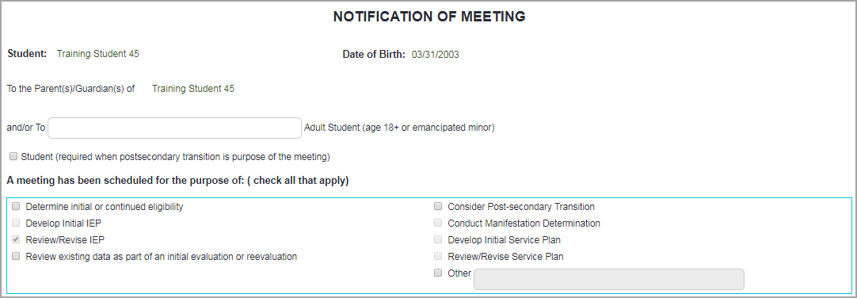
NOM – Purpose of Meeting
Select the purpose / purposes of the meeting
Can select multiple
If "Consider Post‐secondary Transition" is selected
Student Name / Title autofill in Participants section
First Agency field becomes required
Notification of Meeting – Purpose of Meeting
"Review/Revise IEP" is preselected as a meeting purpose because this is an Annual IEP.
Other purposes are preselected in other events
Preselected purposes cannot be unchecked
Some purposes are disabled ("greyed out") because they cannot be combined with this meeting
Select any additional purpose / purposes of the meeting you are scheduling.
The option for Post‐secondary transition must be selected for every IEP once the student turns 15
When this option is selected
The box at the top for "Student (required postsecondary transition is purpose of the meeting)" is checked automatically
The student’s name and title autofills in the Participants section and cannot be removed
The first "Agency" row is required
"Other" can be selected if needed
Any purpose entered in "Other" must be related to the event

Slide 10
NOM – Meeting Date
Complete required fields – outlined in red
If Meeting Date is in the past a Confirmation window appears when the form is saved. Select Cancel to change the date or Proceed if date is correct.
Date Sent must be on or before the Meeting Date
Meeting Date
Meeting Date is required
Enter the date of the meeting
Click in the field then select the Meeting Date on the calendar
If the Meeting Date is in the past, a Confirmation window appears when the form is saved. To keep the date, select "Proceed". To change the date, select "Cancel" and revise the date.
It is OK to have a past date for some events, but it should never happen for an Annual IEP because the parent must receive a copy BEFORE the meeting
Parent must receive a printed copy of the NOM at least 10 days prior to the Meeting Date unless they have waived the 10 day notification requirement
The Meeting Date becomes the Scheduled Date on the Scheduled Events panel
Events cannot be locked if the Meeting (Scheduled) Date is in the future
Date Sent must be on or before the Meeting Date

Slide 11
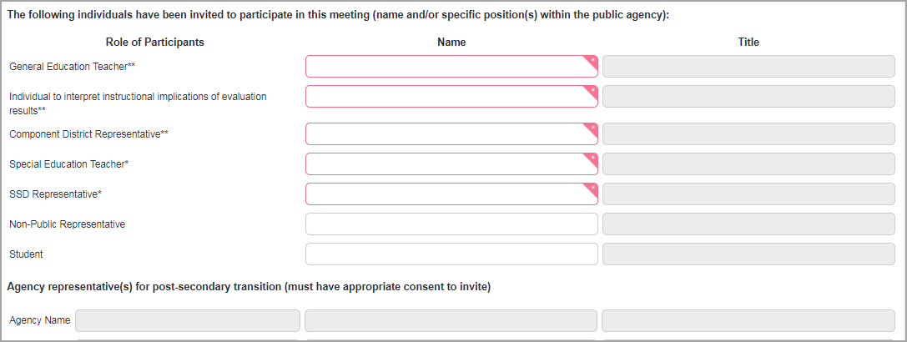
Notification of Meeting ‐ Participants
Enter all participants invited by SSD
Note there are participants that may be excused
Can enter more than one name on a line
"Other" fields available
Participants
Enter all participants being invited by SSD
Best practice is to enter ALL teachers even if they aren’t expected to attend, and anyone else who might attend (principal, etc.)
"Individual to interpret . . ." can be SPED teacher but could be School Psych if reevaluation is being discussed
Component District Representative is usually a counselor or principal from the partner district – in some districts this can be the regular ed teacher – be sure to check first!
SSD Representative: Best practice is to enter SSD Administrator, but it can be an SSD Teacher
Non‐Public representative (for SNAP students only): representative from a private school
Student: must be entered if 16 or over (autofills when post‐secondary transition is marked as purpose of meeting)
Agency Representative: for Post Secondary transition – training provided elsewhere. If fields are disabled (grey), select "Consider post‐secondary transition" as a purpose of the meeting to activate the fields
Part C Representative: for students under the age of 3
Related Services Provider: can be SLP, OT, PT, etc. – not required for all students
More than one person can be entered on a line (for example, multiple GE teachers) to save space
Note the asterisks indicating which participants can be excused with agreement of parent, SSD rep, and partner district rep (aka The Big 3)
This is documented on the Excusal form in the IEP which must be completed and signed before the IEP meeting begins – can be done just prior to the meeting if necessary
If parent does not agree to excuse a required participant, the meeting must be rescheduled
DESE Reminder: The Family Educational Rights and Privacy Act (FERPA) requires that a written Release of Information MUST be obtained for other persons invited by the parent or SSD to share confidential information at the IEP meeting. When inviting an outside agency to discuss post‐secondary transition needs and services, a separate authorization is required for each IEP meeting held. The Student Information Exchange Form can be found at SSD Life>Resources>Forms or by searching the site.

Slide 12
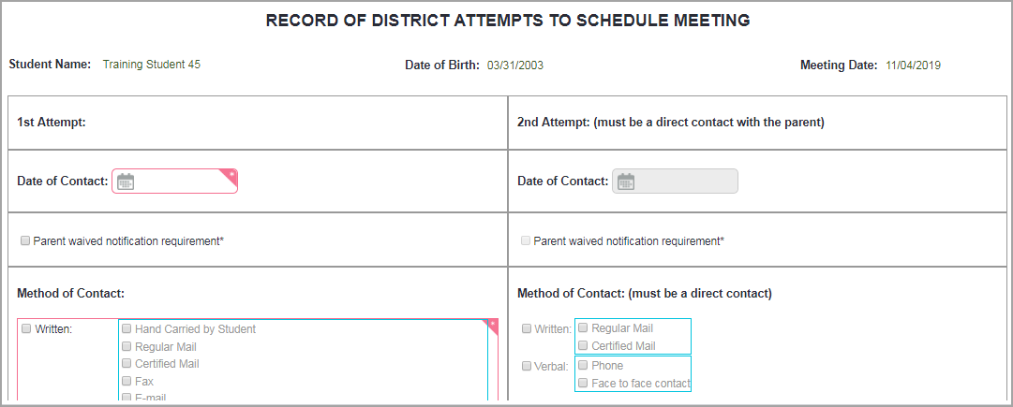
Record of Attempts
Records attempt to schedule meeting – not all contacts made
First attempt is required
Second needed only for "Cannot attend. . ." or "No response"
Record of Attempts
Included in the Notification of Meeting event
Records attempt to schedule and hold the meeting
Do not enter all attempts on this form – only those when meeting has been scheduled and letter is sent
Record other contacts (phone calls, emails, etc.) on the student’s parent contact log
Complete by filling out the required fields
The first attempt (left side) is required
The first attempt should be at least 10 days prior to the meeting date. If it is not the parent must waive the 10‐day requirement and you must check the box
The 10‐day requirement can be waived by the parent, but never by the district
Choice must be made in the Parent Response section of the First Attempt in order to print the NOM
If you were unable to make contact with the parent use "Yes, I’ll be there" to prevent the 2nd attempt from being required – can change later if necessary
The second and third choices should only be used if the meeting is being rescheduled for some reason (parent requested a different date, there was no response from the parent and they did not attend the first attempt to hold the meeting)
If the parent response choice changes you must select Create/Store Invite again to store that version. If this is not done the new NOM/ROA will be lost when the IEP is locked.
Second Attempt – used if the meeting is rescheduled
If, after the first attempt to hold the meeting occurs, the Parent Response is either "Cannot attend" (parent requests reschedule) or "No Response" (the parent does not attend on the first scheduled date), the second attempt becomes required. The second attempt is only used after a first attempt has been made to hold the meeting.
Only two attempts are required before holding the meeting without the parent
If a second attempt is required, an additional 10‐day notice is required

Slide 13
NOM – Validation Check
Click Validation Check
Message appears indicating "Validation Check Successful" or error message appears
If Validation Check is successful, continue
Form Status shows "Compliant" when Validation Check is successful
Validation Check
When both the NOM and Record of Attempts are complete, click “Validation Check” on one of the forms, or return to Event Overview.
Form Status remains "NOT MODIFIED" (unless the event has been closed and reopened).
Phoenix only checks for Compliance, and updates the Status of each form, when you click "Validation Check" or when the event is closed and then reopened.
Click Validation Check
If event is compliant a message will appear (compliance means no fields required by Phoenix are blank – does not check for legal compliance, only for Phoenix compliance)
If event is not compliant, a box will appear listing the errors
Fix the errors, return to Event Overview and do another Validation Check until the event is compliant
If you can’t figure out how to correct an error, contact the Service Desk
When the Validation Check is successful, the Status for both forms will be "COMPLIANT" with green fill
The NOM can only be locked (Create/Store Invite clicked) when the Status column displays "COMPLIANT" for both forms. If "NOT COMPLIANT“ (yellow fill) appears for either form, it must be completed.

Slide 14
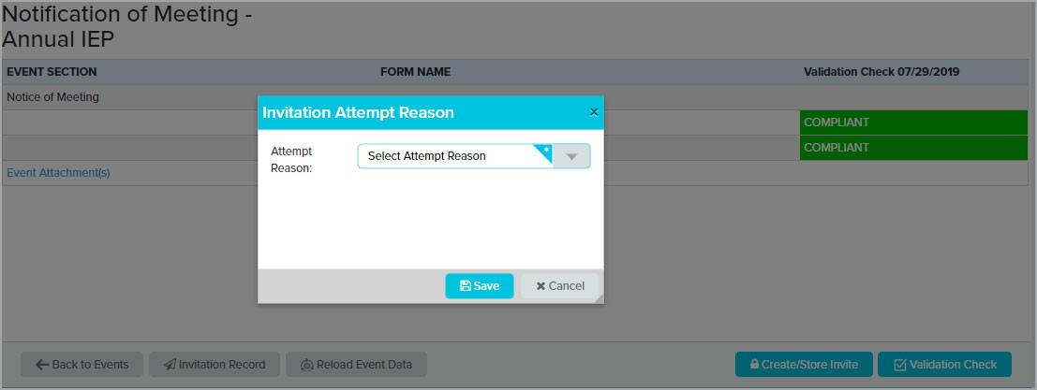
NOM – Create/Store Invite
When Notice of Meeting and Record of Attempts are Compliant click Create/Store Invite
Select Invitation Attempt Reason
Save
Create/Store Invite
NOTE: A printed copy of the Notification of Meeting MUST be provided to the parent at least 10 days prior to the meeting even if agreement about date and time has been made some other way. There is information on the NOM that is legally required to be provided to the parent.
Printing the Notification of Meeting
Click Create/Store Invite
"Create/Store Invite" stores a PDF copy of the Notification of Meeting and Record of Attempts.
Select the Invitation Attempt
Same attempt reason can be used multiple times if necessary
Save
Reminders:
The IEP cannot be locked if "Create/Store Invite" is not selected for the Notification of Meeting event
If information is changed on either the Notification of Meeting or the Record of Attempts, the form must be Saved AND "Create/Store Invite" must be also be selected to "Lock" and store the most recent version of the forms. If "Create/Store Invite" is not selected, the newest version will not be saved when the IEP is locked.

Slide 15
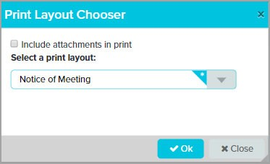
NOM – Printing
Select "Notice of Meeting" from print layout menu
Click OK
PDF of Notification opens
Use PDF controls to print
Record of Attempts is not printed or sent to parent
Printing the Notification of Meeting
After clicking "Create/Store Invite" the Print Layout Chooser window appears
Select "Notice of Meeting"
Record of Attempts is "For Internal Use Only" – it is not printed for the parent. It is only printed if needed by the district.
Select OK
Select Cancel if printing is not needed at this time
A copy can always be printed from the Invitation Record
The PDF of the form will open in a new window or tab depending on browser settings
To print, click the printer icon on the PDF tool bar
To print only page 1, use the printer controls to change the print range
After viewing/printing the form, close the window or tab to move on.
To correct an error on the NOM, reopen the form
The information from the previous notice will be filled in (If "Create/Store Invite" was clicked, the previous version has been stored and can be viewed/printed if needed)
Make the necessary corrections, save and "Create/Store Invite" to store new version
No need to reopen the Record of Attempts (unless an error was made there)
To reschedule a meeting:
Reopen the Notification of Meeting. The information from the previous notice be complete.
Update the information and save
Open the Record of Attempts and complete the side for 2nd attempt
Save and "Create/Store Invite" again choosing the appropriate Invitation Attempt Reason

Slide 16
NOM Envelope Icon
The Envelope icon fills in
The number indicates the number of Notifications Created and Stored
NOM Envelope Icon
When a Notification of Meeting has been created and stored, the envelope icon on the Scheduled Events panel fills in.
A number indicates the number of notifications that have been created and stored.

Slide 17
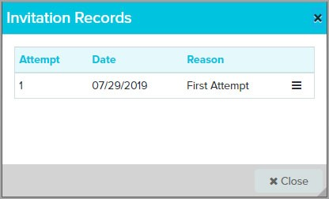
Viewing and Printing Stored NOMs
Open Notification of Meeting
Click Invitation Record
Each stored NOM is listed
Click hamburger icon
Select "Notification of Meeting"
Viewing Stored Notices of Meeting
Every time "Create/Store Invite" is clicked, a PDF copy of the Notification of Meeting and Record of Attempts is stored under "Invitation Record". If a new copy of the original form is needed, it is not necessary to "create/store" another copy. Open the Invitation record and print the original.
Use the Invitation Record to view/print saved NOMs and ROAs
Open Notification of Meeting
Click Invitation Record
Select the hamburger icon
The form opens
Form can be printed by using the PDF controls
Close the form
Note that the Date on the Previous Invites window is the date the NOM was "Stored", not the Meeting Date.

Slide 18
Annual IEP

Slide 19
Annual IEP – Event
Click the name of the Annual IEP event to view the Event Overview.
The Annual IEP has several sections. Click the form name on the Forms List panel or the Form Name list to view the form.
Annual IEP – Overview
The Annual IEP has several sections, some of which include several forms.
Not all forms are visible on the Overview when the event is opened for the first time. Some forms are "hidden" and do not appear until an action is taken to create them. For example, Form D‐Part 1 to document the student’s participation in the Grade Level Assessment, is not visible until it is created by selecting that option on the Special Considerations form. The form then appears on the lists with a star indicating it is required.

Slide 20
Event Overview Icons and Buttons
Buttons and icons are the same as the Notification of Meeting with exception of Lock Event
Only Lock Event after Validation Check and proofreading
Once locked, an event cannot be unlocked
If error is discovered after locking, an IEP Correction event must be completed or event deleted and redone
Stars indicate required forms
Overview Icons and Buttons
A star indicates the form is required
Some forms are required when the IEP is started, others become required as work is completed in the IEP
If there is no star the form is "optional" which means the IEP can be locked if it is not complete
Some "optional" forms are legally required for specific circumstances. For example, the Notice of Action is "optional" in Phoenix but required in many situations.
Buttons at the bottom of the Overview
Same as the Notification of Meeting except
Lock Event – also found at the bottom of all forms and screens
If the event is technically "compliant" when the lock button is clicked, a confirmation message will appear, and you will be able to lock, even if the event is not DESE compliant
As no event in Phoenix can be unlocked, it is critical to remember that if an IEP event is locked and a mistake has been made, a correction event will have to be completed or, if the event was user created, the event will have to be deleted and redone
Best practice is to click "Lock" on the Overview only AFTER the Validation Check is successful and the event has been "printed" and proofread

Slide 21
Form Buttons
Back to Events: Closes the event and returns to Events list
Print: Create the event PDF in order to print
Lock Event: Locks the event
Validation Check: Checks form compliance and gives the user the opportunity to view errors on the form and throughout the event
Save: Saves the entered information. The Save button is active only when there is information to be saved.
Form Buttons
At the bottom of each form is a series of buttons.
Back to Events: Closes the event and returns to Events list
Print: Create the event PDF in order to print. Prints all completed forms in the event, not just this form.
Lock Event: Locks the event if the event is compliant. Remember, there is a difference between Phoenix compliance and DESE compliance. You should always print and proofread before locking any event as events cannot be unlocked. If an error is found in a locked IEP an IEP Correction event must be created and completed.
Validation Check: Checks form compliance (Phoenix compliance) and gives the user the opportunity to view errors on the form and throughout the event.
Save: Saves the entered information. The Save button is active only when there is information to be saved. If new information has been entered but the Save button is not active, click in a white space on the form. That will activate the Save.
The Save button does not activate if the cursor is inside a field. It is not necessary to locate the cursor, just click in a white space outside of a field.
Optional forms, such as the Excusal, have an additional button that appears when the form is saved. The "Set Status to Not Modified" button is used to reset a form that is no longer needed so it does not appear in the locked event.

Slide 22
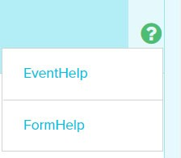
Using Phoenix Help from Event or Form
To open Phoenix Help when inside an event or form click the Help Icon (the question mark)
Choose Event Help when on Event Overview
Using Phoenix Help when in an event or form
Click the Help icon (the question mark) in the upper right corner
When on the Event Overview the only option is Event Help
When on a form or screen (Federal 4 Summary, Assessments, Classroom Accommodations, Goals and Services), both Event Help and Form Help can be selected
The help page opens as a new tab or new window depending on browser settings

Slide 23
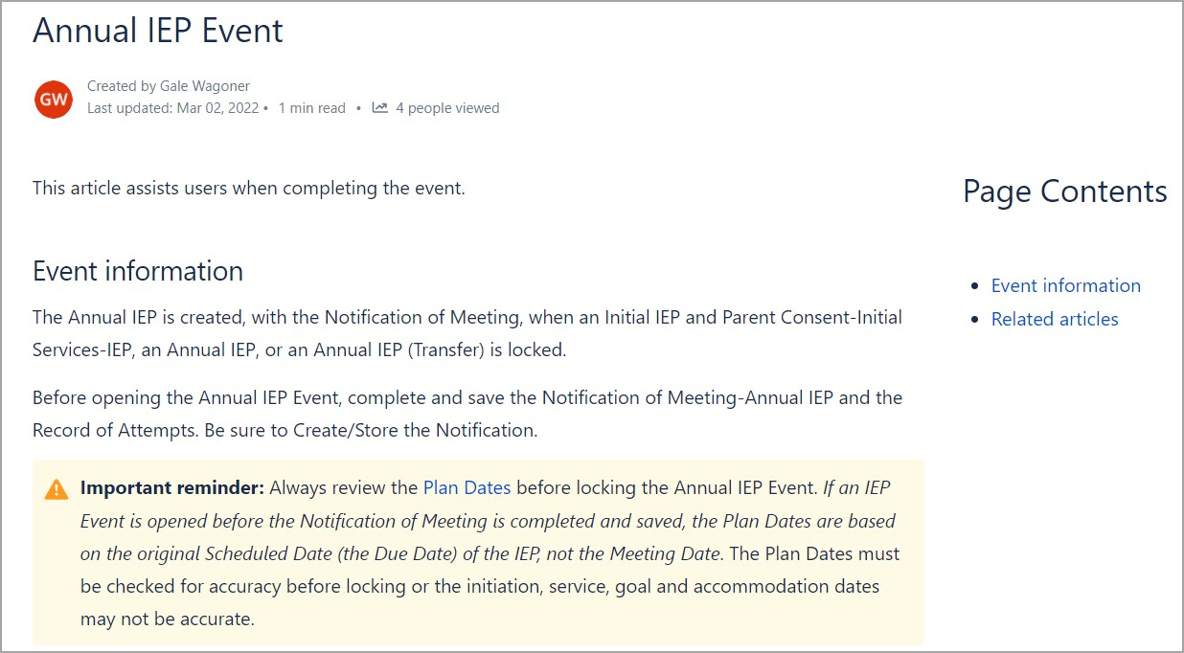
Event Help
Event Help page – information about the event including important reminders
Event Help
If a Help window or tab is already open when a new Help page is chosen, the new page will open in a new window/tab
Can keep the tab or window open and click back and forth between Phoenix and the Help Site
If the help page opened in a new window close or minimize the window to return to Phoenix
Return to Phoenix by closing the tab/window or clicking the tab/window for Phoenix

Slide 24
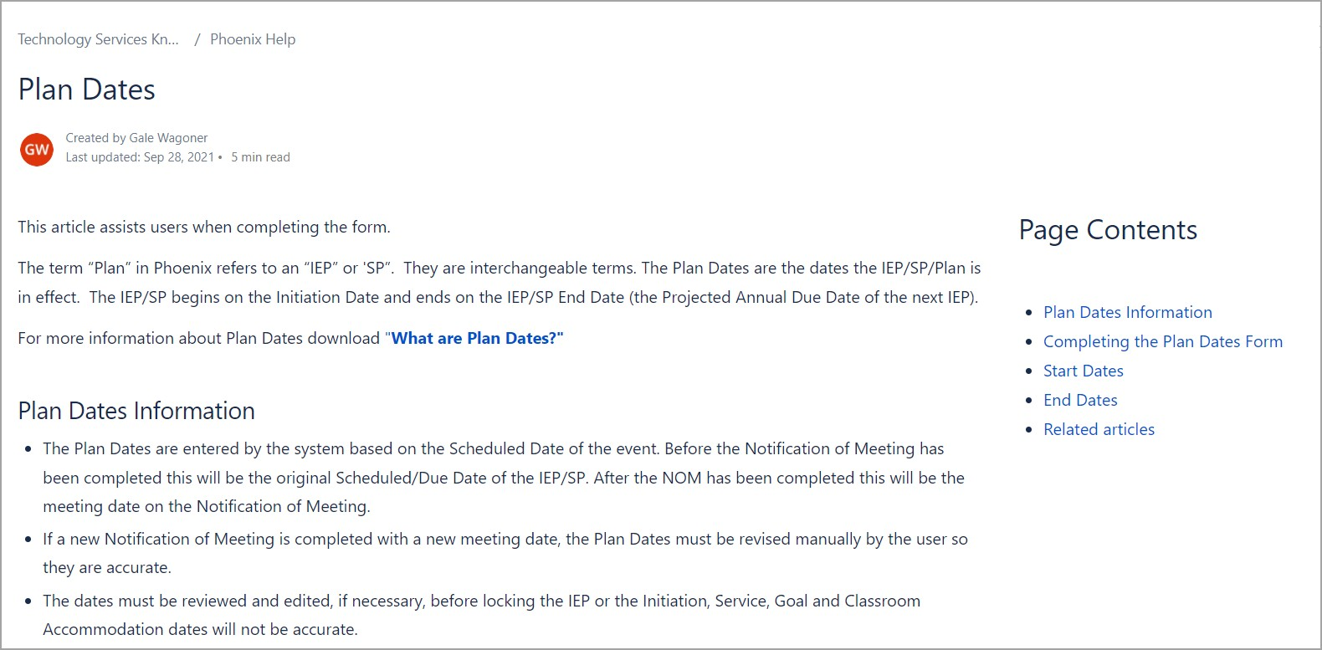
Form Help
Use anchors on right to navigate to specific section
Form Help page
Select Form Help
Phoenix Help – Form Help
To view Form Help
Click the Help Icon in the upper right corner of any form or screen
Choose Form Help
The Help page for the form you are on will open (in this case the Plan Dates)
Form Help pages contain step by step directions for completing the form as well as some tips and reminders. Some also include links to support documents.
Click the anchors on the right to navigate through the longer pages
Return to Phoenix by closing the tab/window or by clicking the Phoenix tab/window

Slide 25
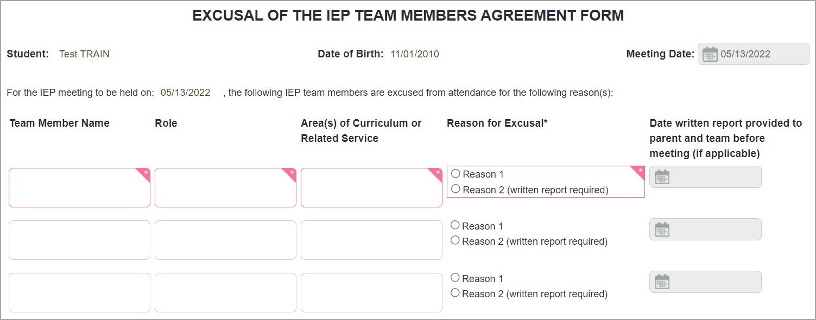
Excusal
Documents agreement that required participant(s) will not attend meeting
Must be completed and signed prior to start of meeting
Excusal
Used to document agreement that required participant/participants will not attend meeting. Only used for IEPs, not Reevaluations, Amendments, etc.
Enter Name, Role and Area of the role being excused
It is the role being excused, not a specific person – the person filling the role doesn’t have to be the same person who was on the Notification of Meeting. If the role is filled for the entire meeting, an Excusal is not needed.
Must be completed and signed prior to start of meeting
If parent agrees before NOM is sent, this can be sent with it, but it still must be signed and received prior to the meeting
Can be signed just before meeting begins but not during or after
All signed documents must be copied so a copy can be provided to the parent and added to the student’s teacher file. The original of any signed document is sent to Student Records at SSD Central Office.
If parent does not agree to the excusal, the meeting must be rescheduled at a time when all required participants can attend.
Note: If this form has been created, completed and saved but is no longer needed, it can be reset so it is not included in the final, locked IEP. Instructions are on the "Resetting Forms in Phoenix" handout and in Phoenix Help.

Slide 26
Resetting an "Optional" Form
If an "Optional" form such as the Excusal is started and saved but is no longer needed it can be reset
Click "Set Status to Not Modified" at the bottom of the form
Confirmation message appears
Click "Yes"
The Form Status returns to "Not Modified"
Information is not deleted
Form will not be included in locked IEP
Can be used with any "Optional" form once it is saved
Resetting an "Optional" Form
Once a form has been saved it must be either completed or reset in order to lock the event.
An optional form – one without a star on the Forms List Panel or Overview – that is completed, even partially, and saved, but is no longer needed, can be "reset" which means it will not be included in the locked IEP.
If the form has not been saved, click on a different form then choose "Ignore Changes and Continue" on the window that appears. Any information added will be deleted.
The following process is only necessary if the form was saved.
This can be used with any "Optional" form. In an IEP this is the Excusal, Prior Written Notices, and the Additional Information form.
It is not necessary to delete information before resetting. To "Set Status to Not Modified"
Click "Set Status to Not Modified" at the bottom of the form
Click "Yes" on Confirmation window
The "Status" on the Event Overview will return to "NOT MODIFIED" which allows the IEP to be locked even if there is saved information on the form. The form will not be included in the locked IEP.
Resetting does not delete information entered The form will not be included in the locked IEP

Slide 27
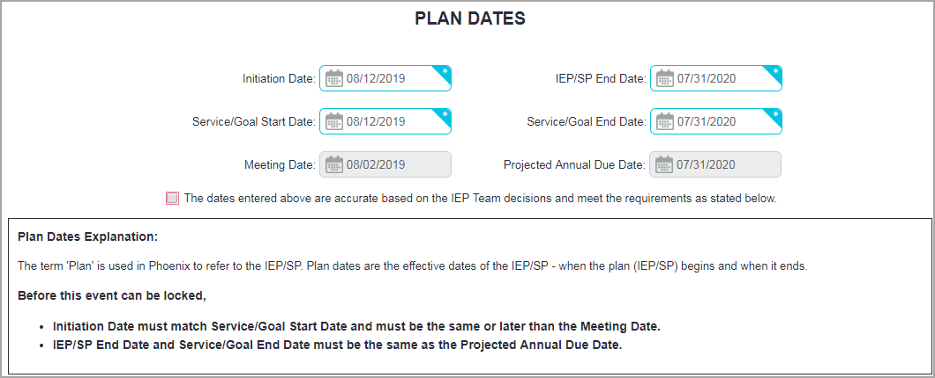
Front Page Section – Plan Dates
Plan Dates are effective dates of the IEP (the Plan)
Calculated based on Scheduled Date on Scheduled Events (Meeting Date on Notification of Meeting)
Critically important that these dates are correct and double checked before locking
IEP cannot be locked if Plan Dates don’t meet requirements
Front Page Section – Plan Dates form
Plan Dates are very important to the system. They are used to determine which IEP, Services, and Goals are "Active"
Plan Dates are:
The effective dates (start and end dates) of the IEP – the "Plan"
Automatically calculated by the system
Based on the Scheduled Date on the Scheduled Events panel when the IEP is opened for the first time.
If the IEP is opened before the NOM is completed, the Meeting Date on the Plan Dates will match the original Scheduled/Due Date.
When the NOM is completed, the Scheduled Date is updated on Scheduled Events to the Meeting Date entered on the Notification of Meeting. The Meeting Date on the Plan Dates form also updates.
All except the Meeting Date and Projected Annual Due Date are editable on the form
If the IEP was opened before the NOM is completed, the Meeting Date and Projected Annual Due Date will update on Plan Dates. The other dates must be manually updated.
The dates must meet the decisions of the IEP team and the requirements on the page
If the Meeting Date on the NOM is changed, the Plan Dates MUST be updated so they are based on new date, not old one.
Check these dates carefully before locking – especially the Initiation Date.

Slide 28
Front Page Section – Plan Dates
Dates must follow rules on the page
Initiation Date must match Service/Goal Start Date and must be the same as or later than the Meeting Date
IEP/SP End Date and Service/Goal End Date must match the Projected Annual Due Date (calculated from Meeting Date)
Plan Dates
Review these dates carefully – they must follow the rules on the page Types of dates and basic rules
Initiation Date: The date the IEP starts and the goals/services become active in Phoenix
Must be on or after the Meeting Date
For K‐12 students should not be more than 10 days after the meeting date for an Annual IEP (per DESE).
Service/Goal Start Date: The date the services and goals will start – must match the Initiation Date
End Dates: The date the IEP, including all services and goals, ends. They must all match the Projected Annual Due Date calculated by the system – 364 days from the Meeting Date.
These dates automatically fill as the Begin and End Dates when a new classroom accommodation, goal, or service is created.
Changing and saving the dates here updates the matching dates on all Classroom Accommodations, Goals, and Services previously entered – message appears confirming changes.
Meeting Date in the grey box only changes when a new Notification of Meeting is completed.
Projected Annual Due Date is calculated from the Meeting Date (Meeting Date + 364 days) – it only changes when the Meeting Date changes – is not user editable
Before locking, check the confirmation box
This box confirms that the dates were checked for accuracy
Wait until ready to lock to check the box so you remember to confirm the dates and update if needed before locking.
Reminder: When the Meeting Date is changed, the Plan Dates must be reviewed and revised as needed to match the decisions made at the IEP meeting and to follow the rules on the form.

Slide 29
Plan Dates – Initiation/Start Dates
Initiation Date is the date on which the IEP starts
Defaults to 10 days after the Meeting Date
Phoenix follows current IEP until the Initiation Date
Per DESE an Annual IEP should start within 10 days of Meeting Date
Service/Goal Start Date must match Initiation Date
Plan Dates – Start Dates
The Initiation Date is the date on which the IEP starts, and the date Phoenix activates the plan, including the goals and services.
In an Annual IEP for students in grades K – 12, the Initiation Date of the IEP should be on, or no more than 10 days after, the IEP Meeting Date.
Per DESE, no undue delay can occur in providing special education and related services to the child. If a delay is necessary, the reasons must be documented.
Prior to this date the goals, services and accommodations appearing in Phoenix and in Phoenix Reports are for the previous IEP (the Active Plan).
This date should be checked carefully before locking the IEP.
The IEP can be locked even if the Initiation Date is more than 10 days after the meeting date. In some cases (for example: EC IEPs written for Fall implementation, Initial IEPs when the parent signed the Consent for Initial Services PWN more than 10 days after the Meeting Date) this is correct.
The Initiation Date is the date the IEP becomes the "Active Plan" in Phoenix.
Progress reports created prior to the Initiation Date will be for the previous IEP if the goals are active. If the goals in the previous IEP are not active (the IEP has expired), no reports will be created.
Information in district reports reflects data from the previous IEP until the Initiation Date.

Slide 30
Plan Dates – End Dates
The IEP/SP End Date, Service/Goal End Date and Projected Annual Due Date must be the same
The Date is 364 days after the Meeting Date
Projected Annual Due Date updates when a new Meeting Date is entered on a Notification of Meeting
IEP/SP End Date and Service/Goal End Date must be updated manually
Plan Dates – End Dates
The End Dates are the date the IEP ends
They must all match the Projected Annual Due Date
All classroom accommodations, goals and services end
No Amendment or Correction can be done after the end date
The Projected Annual Due Date updates when the Meeting Date changes on the Notification of Meeting. The IEP/SP End Date and Service/Goal End Date must be updated manually or the IEP cannot be locked.
The End Dates must all match. If the IEP will end prior to that date (the student is graduating, etc.), the IEP is ended when Student Data exits the student. The End Dates cannot be changed.
Remember: If you must update the End Dates the Start Dates will have to be edited as well. They may meet the Phoenix rules, but they won’t be accurate for the IEP.

Slide 31
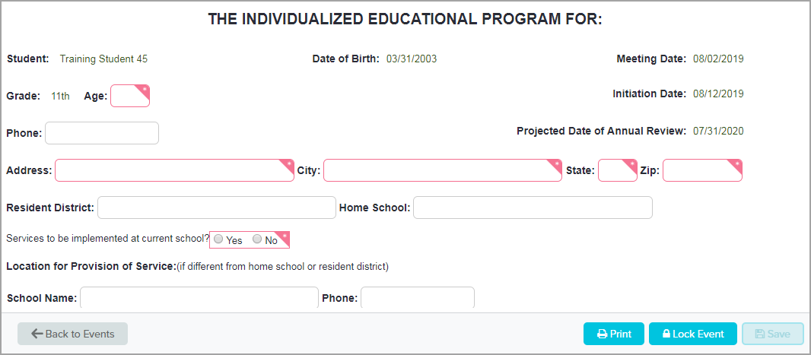
Front Page Section – Front Page‐IEP
Some fields autofill
Required fields must be completed by the user
Some "editable" fields may need to be completed
Front Page – IEP
Complete required fields
The age field is required – you can see the student’s age on the blue student header at the top of the screen
Check the Initiation Date
It fills from the Plan Dates form – can only be edited on the Plan Dates form
Annual IEP for a K12 student: If it is more than 10 days later than the Meeting Date, it should be corrected on the Plan Dates form. After changing the Plan Dates form the date updates on the Front Page.
The Initiation Date should only be more than 10 days later than the Meeting Date for Early Childhood IEPs being written for the next school year, or when awaiting parent consent for an Initial IEP.
Be sure to look at all fields – Remember, a grey outline is only technically "optional". Some "optional" fields are legally required for some students in some scenarios. For example, the "Location for Provision of Service" section is grey but is required if the student is not attending their Home School.
If any demographic information is incorrect, it can be changed if in an editable field
Student Data Secretary should be notified to have data corrected in ESI (the Student Data system).
If information in green text is incorrect, contact Student Data Secretary who will correct it
Correction will be available the following day. Data corrections made today in ESI will not be visible in Phoenix until the day after the change is made.

Slide 32
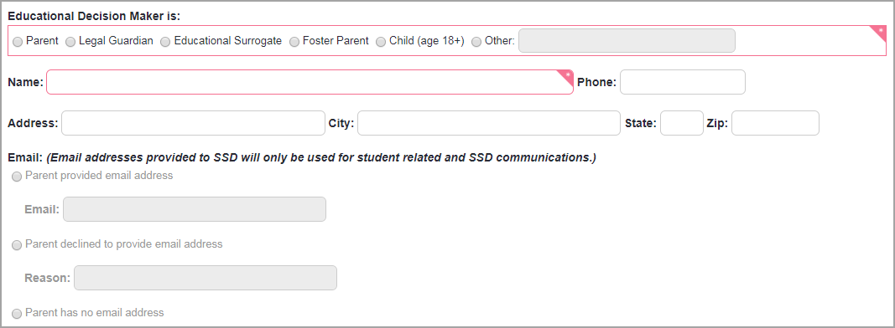
Front Page‐IEP EDM Email Address
Enter name of Educational Decision Maker (parent/guardian/student age 18+)
Select email option
Enter email address or reason email was not provided
Required for first Parent name
Front Page IEP – Educational Decision Maker section
Enter the name of the first Educational Decision Maker (Parent/Guardian/Student age 18+)
Enter phone number
Check address – revise if needed
Make selection in Email section
Parent provided email address: Enter email address
Parent declined to provide email address: Enter reason parent declined
Parent has no email address
If there is a second EDM, complete the second section
NOTE: The district uses EDM email addresses for parent communication. It is the parent’s option to provide or not provide the address. If they give you an address they are willing to share with the district, it must be provided to Student Data so it can be entered in ESI – the student Data side of the program. Entering it here does not enter it into ESI. If the address changes, the change should be sent to Student Data.

Slide 33
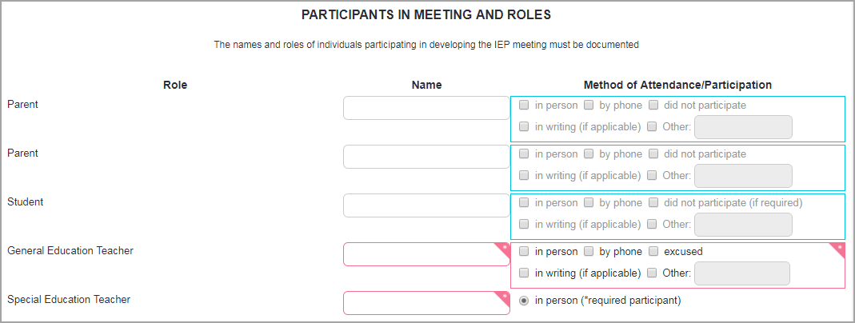
Front Page‐IEP – Participants
Enter Parent’s Name – mark appropriate method of Attendance/Participation
Enter names and Method of Attendance/Participation for all participants
Front Page – Participants
In the participant section
Complete all required fields
The Parent Name field has a grey outline. However, the district requests that this field is completed for data purposes. Enter the parent/guardian/EDM name and if they do not attend, or participate in another way, mark "Did not participate".
The "Other" text field is limited to 10 characters.
Enter everyone who attended/participated or was excused but no one who did not attend/participate and was not excused

Slide 34
Front Page – Participants
If a participant is marked "Excused" an Excusal form must be completed
If additional space is needed choose "Additional Participants" at the bottom to create new page
Front Page – Participants
If a participant is marked "Excused" the Excusal form must be completed in the IEP. This is an example of a DESE requirement that is not a Phoenix requirement. Phoenix will not require you to complete the Excusal but if it is not included in the IEP when a participant is marked "Excused" on the Front Page, the IEP is out of compliance.
If there isn’t room for all participants, select "Additional Participants" at the bottom of the Front Page which will create the Front Page – Additional Participants form on the Forms List Panel and the Event Overview when the Front Page‐IEP is saved
If the Additional Participants form ends up not being needed, return to Front Page and "uncheck" the box. The form will disappear. If information was added and saved, the form must be reset.
If you attempt to open another form before saving the one you’re working on
Message appears asking to save or ignore changes
Choose "Let me save changes" to save
This does not save the changes
Must click Save
Choose "Ignore" to remove any unsaved information and start form over again
Reminder: Never click "Lock" when on a form
It does not lock the form – it starts the lock process if the event is compliant
Always do a Validation Check on a form or the Event Overview and proofread before locking
Save – Saves the form

Slide 35
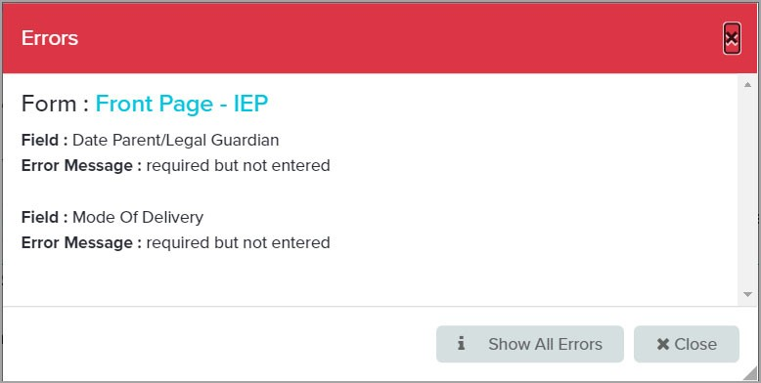
Validation Check on a Form
After saving a form, Validation Check can be used to check for errors
Compliance is checked for the form and event
Errors for the current form display
Click the name of the form or "Close" to address the errors
Click "Show All Errors" to view errors on other forms/screens
Validation Check on a Form
Validation (compliance) can be checked for an individual form after saving.
Click Validation Check
Compliance is checked for the form and the event
If there are errors on this form or in the event, the Errors window opens
If there are errors on the current form, they display
If there are errors on other forms/screens, the "Show All Errors" button is visible
To address the errors for the form click either the link for the form name or close the window
To view errors on other forms/screens, click "Show All Errors"
Tip: It is best to do Validation Checks only after most, or all, forms have been completed.

Slide 36
Validation Check – No Errors on Form
If there are no errors on the current form but there are errors on other forms/screens in the event, a message appears along with the "Show All Errors" button
Click "Show All Errors" to view errors on other forms/screens
Validation Check – No Errors on Form
If there are no errors on the current form but there are errors on other forms or screens in the event a message will appear "All required fields have been completed on this form" and the "Show All Errors" button also appears
Click "Show All Errors" to view the errors in the rest of the event.
If there are no errors in the event a green message will drop down from the top of the screen saying “Validation Check Successful”.

Slide 37
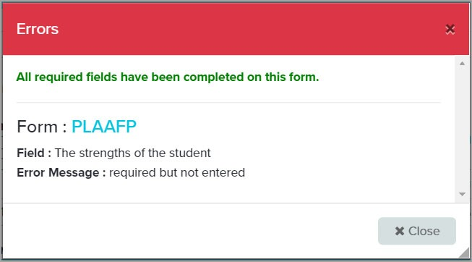
Validation Check – Open Form with Errors
Click the form name to open the form and correct the errors
Validation Check – Open Form with Errors
After clicking "Show All Errors" a list of all errors in the event appears. The name of the form is a link. Click the link to open the form to correct the errors.

Slide 38
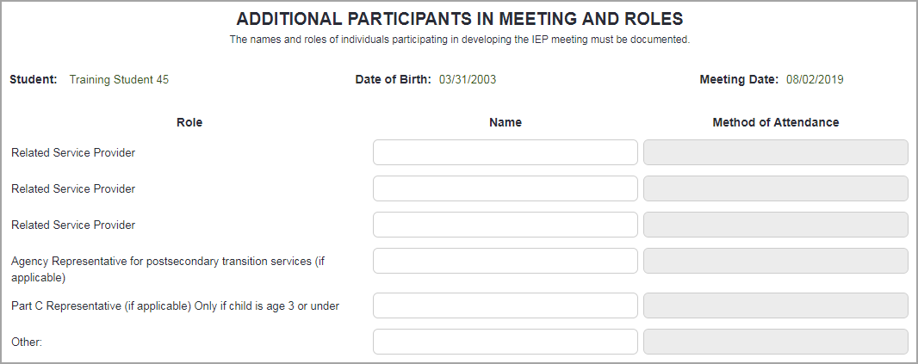
Front Page – Additional Participants
Space for additional participants
Front Page – Additional Participants
The Front Page – Additional Participants form is used to document participants that do not fit on the Front Page – IEP.
None of the fields are required by Phoenix but, if this is a student age 15 or over, the Agency fields must be completed for post‐secondary transition.
Note: If this form has been created, completed and saved but is no longer needed, it can be reset so it is not included in the final, locked IEP. Instructions are on the "Resetting Forms in Phoenix" handout and in Phoenix Help.

Slide 39
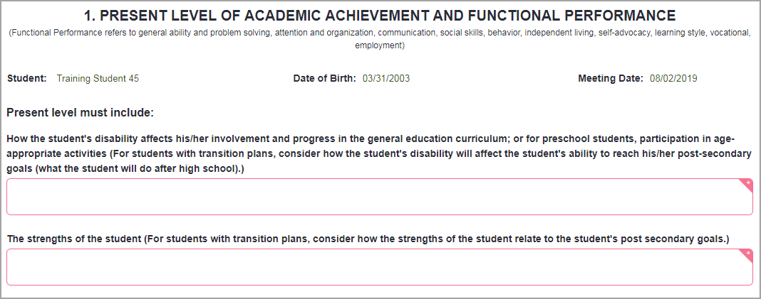
PLAAFP Section – PLAAFP
Text fields expand – no character limit
Can type or copy/paste as plain text
All providers enter information on the PLAAFP
Save frequently
PLAAFP
Fields are expanding text boxes with no character limit
Information can be typed or copied/pasted from a word processing document.
If using copy/paste, save your original document as plain text before copying or, when pasting, right click and select "Paste as plain text". Do not use keyboard commands. Formatted text can cause issues when locking and printing the IEP.
Many forms in Phoenix have expanding text boxes with no character limit.
Complete required fields
Indicate if student is taking an alternative assessment (MAP‐A)
If yes, choose "benchmarks/short‐term objectives are on goal page"
Note: All providers, including all related service providers, will enter their present level information on the PLAAFP form. There is only one Additional Information form in the IEP and because of the expanding text boxes available in Phoenix, it should not be used for present level information. It is the responsibility of the IEP Chair to ensure that the information is easy to read (is parent friendly).
Reminder: Phoenix does not auto‐save information on forms. It is important that you save frequently as you work – especially on the PLAAFP.

Slide 40
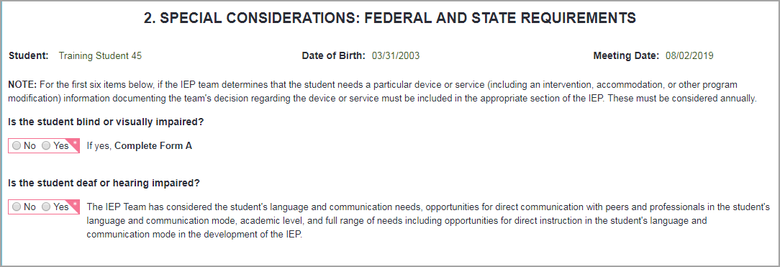
Special Considerations
If Yes is selected for section requiring a form – the form is created on the Forms List panel and the Event Overview (for example, Form A)
Special Considerations
Answer questions on the form
Some questions create additional forms which appear on the Forms List Panel and Overview when the Special Considerations form is saved.
Transfer of Rights section
If the form is needed for this IEP (student is 16 or 18)
select "Notification was given"
enter the date the ORIGINAL form was provided
select the box for "Form is needed for this IEP. This creates the Transfer of Rights form.
If the student is 16, 17, or older than 18 and the form was previously provided
select "Notification was given"
enter the date the first form was provided
do not click the "Form is needed . . ." box
When the student turns 18 the form is issued a second time
select "Notification was given"
enter the date the first form was provided
select the box for "Form is needed for this IEP. This creates the Transfer of Rights form.
Phoenix does not "nanny" users – you must be aware of all legal requirements that must be completed
For example, if Form D indicates the student will use accommodations on state assessments, the Assessments screen must be completed but Phoenix will not require it or remind you
It is possible to lock the IEP without entering the accommodations
In this case an IEP Correction would have to be completed
If a form has been selected but was not completed or saved, it can be removed simply by changing your original answer to the opposite.
Note: If any form in this section is created, completed and saved but is no longer needed, it can be reset so it is not included in the final, locked IEP. Instructions are on the "Resetting Forms in Phoenix" handout and in Phoenix Help.

Slide 41
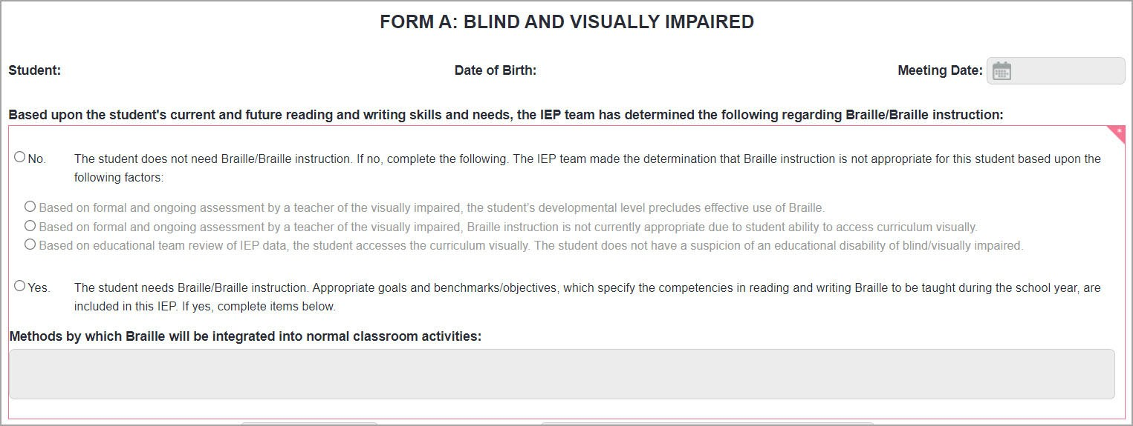
Special Considerations‐Form A
Completed by a Teacher of the Visually Impaired
Form A
In the Special Considerations Section
Created by answering Yes to the question "Is the student blind or visually impaired" on the Special Considerations form.
Completed by a Teacher of the Visually Impaired
Complete all required fields – large text boxes expand
Save
Note: If this form has been created, completed and saved but is no longer needed, it can be reset so it is not included in the final, locked IEP. Instructions are on the "Resetting Forms in Phoenix" handout and in Phoenix Help.

Slide 42
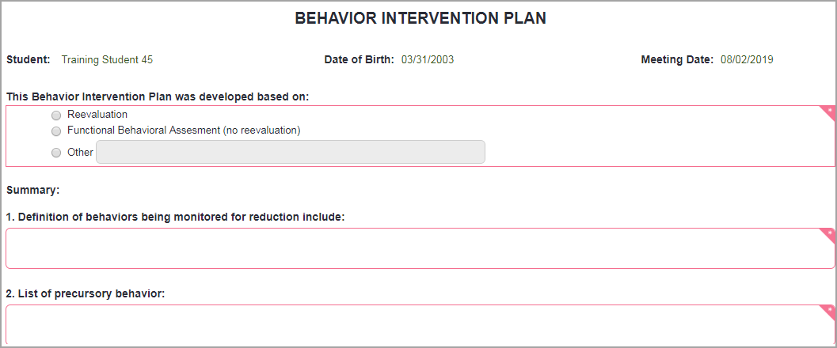
Special Considerations‐BIP
Complete required fields
Save
Questions about the content or use of this form should be directed to your SSD Administrator
BIP Form
In the Special Considerations Section
Created by answering Yes to the question "Does the student exhibit behaviors that impede his/her learning or that of others" on the Special Considerations form THEN choosing "Behavior Intervention Plan".
Complete all required fields – the larger text fields expand.
Save.
If you have questions about the content or use of this form ask your SSD Administrator (Coordinator or Building Principal). You may also download the BIP Supplemental Information Guide from Phoenix Help. The link is available on the BIP Form Help page and on the Resources page > Process Documentation > IEP/Amendment.
Note: If this form has been created, completed and saved but is no longer needed, it can be reset so it is not included in the final, locked IEP. Instructions are on the "Resetting Forms in Phoenix" handout and in Phoenix Help.

Slide 43
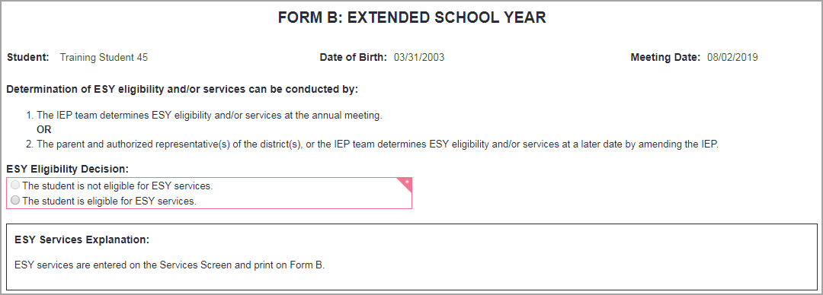
Special Considerations – Form B
Can only select "The student is eligible".
Reminder that ESY Services are entered on Services Screen and print on Form B.
Form B – ESY
In the Special Considerations Section
Created when "Yes, the student is eligible for ESY services" is chosen on the Special Considerations form
The only choice on Form B is "The student is eligible for ESY services" because the form would not be created if the student is not eligible.
A reminder appears that services are entered on the Services Screen. The reminder does not print.
Keep in mind that creating and completing this form is only one requirement of the ESY process.
Goals to be addressed during ESY must be indicated by checking the ESY box on the goal.
ESY Services must be entered on the Services Screen. If they are not, Form B will print with only the top section.
The system will not make the goal or service pieces required so it is possible to lock the IEP with no ESY goals or services entered.
In this case an IEP Correction must be completed.
This can be avoided by printing and proofreading the IEP before you lock it.
Note: If this form has been created, completed and saved but is no longer needed, it can be reset so it is not included in the final, locked IEP. Instructions are on the "Resetting Forms in Phoenix" handout and in Phoenix Help.

Slide 44
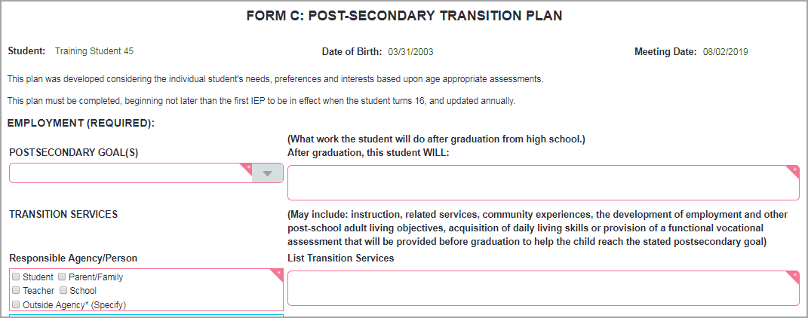
Special Considerations – Form C
Can choose more than one Responsible Person using checkboxes
Text fields are expandable
Form C – Postsecondary Transition
In the Special Considerations Section
Created when either "Yes" or "No (However the IEP team has agreed to complete a Post‐secondary Transition Plan.)" is chosen in the Post‐secondary Transition section of the Special Considerations form
Required for all students who are, or will turn, 16 years of age or older during this IEP – can be completed for any student
Transition Goal text box – should complete the statement printed above it: "After graduation this student WILL"
On the printed form the statement reads "After graduation, I, Student Name, WILL"
Can choose more than one Responsible Agency/Person for each Transition Service
Text boxes expand
Complete required fields
Employment and Education/Training sections must be completed for every student
Independent Living section is optional – if you choose a goal in this section, be sure to complete all legally required fields (goal text, Responsible Agency/Person, Transition Service) even though the fields may not appear to be required
Save
Note: If this form has been created, completed and saved but is no longer needed, it can be reset so it is not included in the final, locked IEP. Instructions are on the "Resetting Forms in Phoenix" handout and in Phoenix Help.

Slide 45
Special Considerations – Transfer of Rights Section
Transfer of Rights section is unique
Form is issued when student is 16 and 18
When the form has been issued once but is not needed for this IEP
Enter the date the original form was issued (not the current IEP date)
Do not select "Form is needed for this IEP"
Transfer of Rights section
The Transfer of Rights form is issued two times – when the student is 16 (not later than one year before the student is 18) and again when the student turns 18.
If the form is needed for this IEP (student is 16 or 18)
select "Notification was given"
enter the date the ORIGINAL form was provided (the date is always the same)
select the box for "Form is needed for this IEP"
the Transfer of Rights form is created
If the form was previously provided at 16 and the student is not 18 (form is not needed for this IEP)
select "Notification was given"
enter the date the ORIGINAL form was provided (the date is always the same)
do not click the "Form is needed . . ." box
no form is created
When the student is 18 the form is issued a second time
select "Notification was given"
enter the date the ORIGINAL form was provided (the date is always the same)
select the box for "Form is needed for this IEP"
the Transfer of Rights form is created

Slide 46
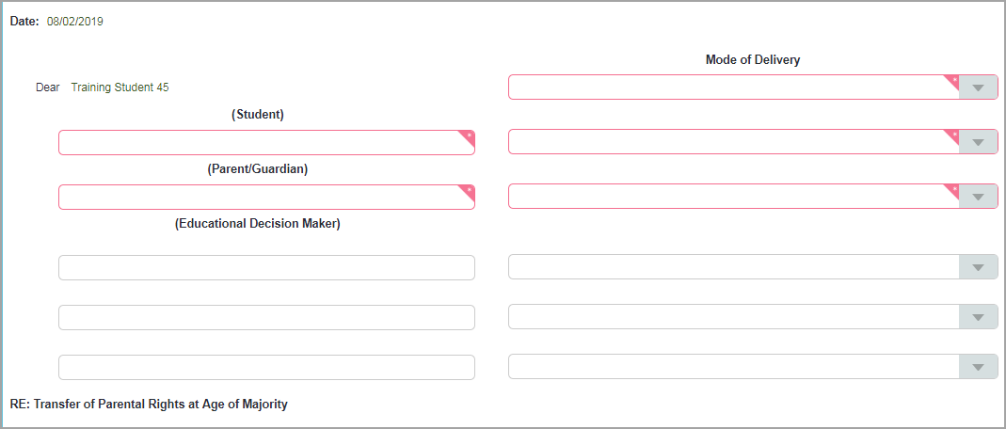
Special Considerations – Transfer of Rights
First issued when student is 16
Issued again after student turns 18
Transfer of Rights
In the Special Considerations Section
Created when, in the Transfer of Rights section of the Special Considerations form, the box for "Form is needed for this IEP" is checked. The box becomes available when "Notification was given" is selected.
It can also be created as a User Created Form if it is needed outside of an IEP
The Transfer of Rights form is issued twice for each student – once at least one year before turning 18 (when they are 16) and once after the student has turned 18
Be sure the Educational Decision Maker (EDM) is correct at the time the form is being completed
Before the student is 18 – parent/guardian
After the student is 18 – student (unless parent has provided documented proof of a power of attorney)
Student Data Secretary must be notified by IEP Chair when the student turns 18. She will change the EDM in the system.
Student’s name and birthdate autofill
Enter the date of the student’s 18th birthday
Complete other required fields
Save
Note: If this form has been created, completed and saved but is no longer needed, it can be reset so it is not included in the final, locked IEP. Instructions are on the "Resetting Forms in Phoenix" handout and in Phoenix Help.

Slide 47
Special Considerations – State Assessments
If the student will participate in a state or national assessment
Select "YES"
Select the assessment(s) in which the student will participate
Appropriate forms will be created based on selections
Special Considerations – State Assessments
The student’s participation in State Assessments is documented in this section. If "Yes" is selected, select the specific assessments in which the student will participate. The appropriate form is then created when the Special Considerations form is saved.
Form D‐Part 1: Grade Level Assessments (GLA)
Form D‐Part 2: End‐of‐Course Exams (EOC)
Form D‐Part 3: MAP‐A
Form D‐Part 4: ACCESS for ELLs
Form D‐Part 5: National Assessment of Educational Progress (NAEP)
If the student will participate in MAP‐A, do not select GLA or EOC.
Tip: if the checkboxes are small on your screen making it difficult to select them, you can zoom your screen to increase the size. Select Control + or Command +

Slide 48
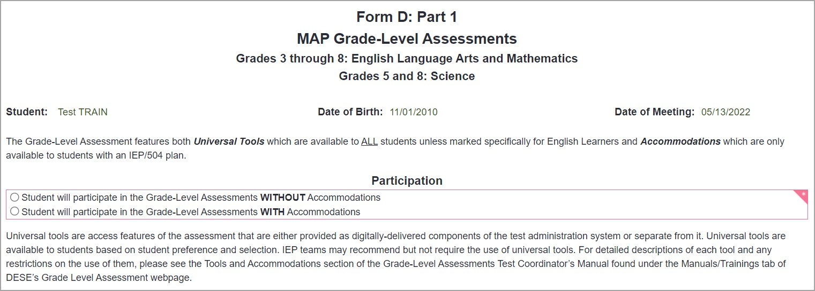
Special Considerations –
Form D – Part 1 – Grade Level Assessments
Make selection for use of accommodations
Complete the Universals sections
Form D‐Part 1 – MAP Grade Level Assessments
Form D‐Part 1 is created when "Grade Level Assessments" is selected in the State Assessments section of Special Considerations. It is a required form.
The form is used to document the student’s participation in Grade Level Assessments (GLA). It is not used if the student is eligible for MAP‐A which is documented on Form D‐Part 3.
Select how the student will participate in a GLA – Without or With accommodations.
Complete the Universals sections. Consult with your SSD administrator for instructions for completing these sections.
Reminder: Accommodations for GLA are entered on the Assessments screen and print on this form.
Note: If this form has been created, completed and saved but is no longer needed, it can be reset so it is not included in the final, locked IEP. Instructions are on the "Resetting Forms in Phoenix" handout and in Phoenix Help.

Slide 49
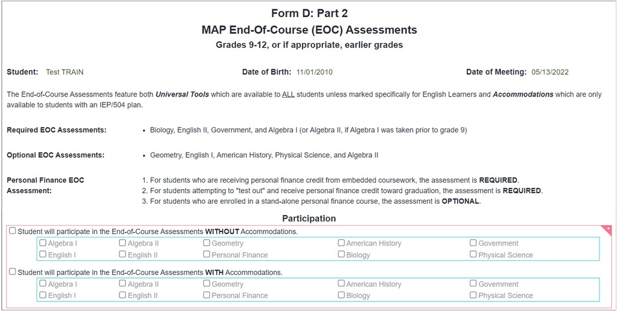
Special Considerations –
Form D‐Part 2 – End of Course Exams
Make selection for participation and use of accommodations
Complete the Universals sections
Form D‐Part 2 – End of Course Exams
Form D‐Part 2 is created when "End of Course Exams" is selected in the State Assessments section of Special Considerations. It is a required form.
The form is used to document the student’s participation in End of Course (EOC) exams. It is not used if the student is eligible for MAP‐A which is documented on Form D‐Part 3.
Select how the student will participate in EOC – Without or With accommodations.
Complete the Universals sections. Consult with your SSD administrator for instructions for completing these sections.
Reminder: Accommodations for EOC are entered on the Assessments screen and print on this form.
Tip: if the checkboxes are small on your screen making it difficult to select them, you can zoom your screen to increase the size. Select Control + or Command +
Note: If this form has been created, completed and saved but is no longer needed, it can be reset so it is not included in the final, locked IEP. Instructions are on the "Resetting Forms in Phoenix" handout and in the Phoenix Help site.

Slide 50
Special Considerations – Form D‐Part 3 – MAP‐A
Select the appropriate section(s)
Complete all required fields
Form D‐Part 3 – MAP‐A
Form D‐Part 3 is created when "MAP‐A" is selected in the State Assessment section of Special Considerations. It is a required form.
The form is used to document the student’s participation in MAP‐A as well as to explain why the student cannot participate in the general education assessment (GLA or EOC).
Select the appropriate areas to be assessed through MAP‐A
Make a selection for Dynamic Learning Maps
Complete the Justification section
Note: If this form has been created, completed and saved but is no longer needed, it can be reset so it is not included in the final, locked IEP. Instructions are on the "Resetting Forms in Phoenix" handout and in the Phoenix Help site

Slide 51
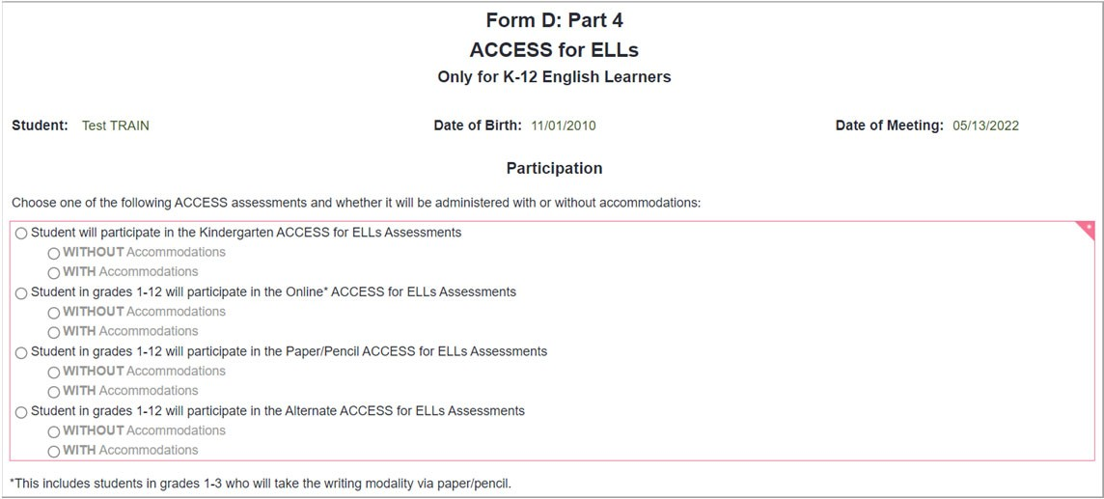
Special Considerations –
Form D‐Part 4 – ACCESS for ELLs
Make selection for participation and use of accommodations
Form D‐Part 4 – ACCESS for ELLs
Form D‐Part 4 is created when "ACCESS for ELLs" is selected in the State Assessment section of Special Considerations. It is a required form.
The form is used to document the student’s participation in the ACCESS for ELLs assessment.
Select the appropriate version of the assessment.
Select if the student will participate Without or With accommodations.
Reminder: Accommodations for ACCESS for ELLs are entered on the Assessments screen and print on this form.
Note: If this form has been created, completed and saved but is no longer needed, it can be reset so it is not included in the final, locked IEP. Instructions are on the "Resetting Forms in Phoenix" handout and in the Phoenix Help site

Slide 52
Special Considerations – Form D‐Part 5 – NAEP
Select the appropriate option
Form D‐Part 5 – National Assessment of Educational Progress (NAEP)
The NAEP is a national assessment administered in selected districts each year.
Form D‐Part 5 is created when "NAEP" is selected in the State Assessment section of Special Considerations. It is a required form.
The form is used to document the student’s participation in the National Assessment of Educational Progress (NAEP) and/or International Assessments.
Select how the student will participate in NAEP – Without or With accommodations.
Reminder: Accommodations for NAEP are entered on the Assessments screen and print on this form.
Note: If this form has been created, completed and saved but is no longer needed, it can be reset so it is not included in the final, locked IEP. Instructions are on the "Resetting Forms in Phoenix" handout and in the Phoenix Help site

Slide 53
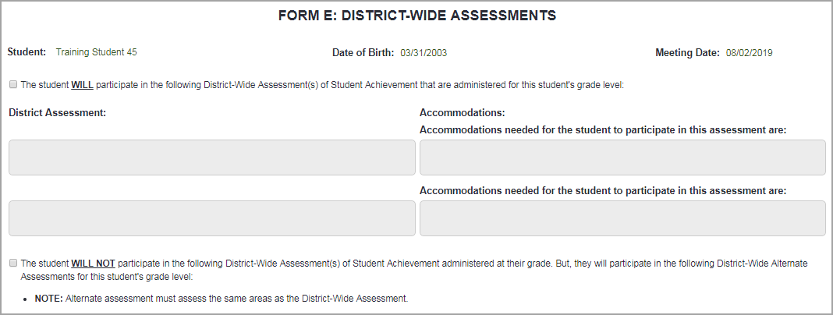
Special Considerations‐Form E
If "The student WILL .." participate in district testing, complete top section
Accommodations are manually entered
If Accommodations will not be used enter "None"
If "The student WILL NOT . . . " participate, complete bottom section
Form E – District Assessments
In Special Considerations Section
Created when "Yes" is chosen for District Assessments on the Special Considerations form.
Completed for students for whom there are district‐wide assessments – whether they are participating or not.
If the student will participate in an assessment, select "The student WILL participate . . ."
Enter the assessment name(s)
Enter the accommodations the student will use. The Accommodations are entered manually – there are no drop downs.
If the student will not be using accommodations, enter "None" in the accommodations field.
If the student will not participate in an assessment, select "The student WILL NOT participate . . ."
Complete the required fields
All text boxes on Form E expand with no character limit
Save
Note: If this form has been created, completed and saved but is no longer needed, it can be reset so it is not included in the final, locked IEP. Instructions are on the "Resetting Forms in Phoenix" handout and in Phoenix Help.

Slide 54
Federal 4 Summary Screen
Summarizes information entered on Assessments, Classroom Accommodations, Goals and Services
Starts blank
Where the LRE is "accepted" (reviewed and saved)
Federal 4 Summary Screen
The Federal 4 Summary fills with information entered on the Assessments, Classroom Accommodations, Goals and Services screens.
The Federal 4 Summary is an excellent place to review the information entered on the screens before locking. You can scroll through the sections, or you can use the airplane icon to "fly to" a specific section.
This is where the LRE is reviewed and "accepted". Selecting "Accept LRE" on the Services screen moves you to the Federal 4 Summary.
More information about the Federal 4 Summary and accepting the LRE is provided later in this training.

Slide 55
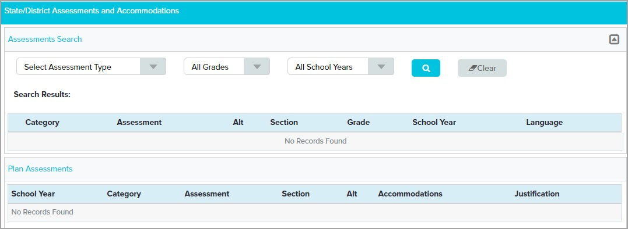
Assessments Screen
Example of a screen
Does not look like printed form
State Assessments and Accommodations are entered here
Accommodations print on the appropriate section of Form D
Assessments Screen
This is an example of a screen, or product screen
Unlike a form, it does not look like the printed form
The information entered in the fields on the screen prints on the appropriate section of Form D
There are 4 screens in each IEP and SP event: Assessments (for State Assessments), Classroom Accommodations, Goals, and Services
State/National Assessments and accommodations are entered on the Assessments screen
Instructions for completing this section can also be found on the Assessments Quick Start Card

Slide 56
Assessments – Search for Assessments
Add GLA, EOC, ACCESS for ELLs and/or NAEP when the student will use accommodations
Not completed if student will not use accommodations or is participating in MAP‐A
Select the Assessment Type
Click the Search icon
Adding State and National Assessments (GLA, EOC, ACCESS FOR ELLS, NAEP) – Search for Assessments
This is where state/national assessments are added and accommodations for them entered.
Assessments are added to this screen only if the student will be participating in Grade Level Assessments, End of Course Assessments, ACCESS for ELLs 2.0, or NAEP WITH accommodations.
Add assessment to screen – in this example a Grade Level Assessment will be added
Select the Assessment Type Choices available
ACCESS for ELLs – English Language Learners
Used as annual English Language Proficiency assessment. Students who are in monitored status for ELL do not take the assessment.
End‐of‐Course Assessments – high school students based on courses taken, not grade level
NAEP – for selected students in selected districts
Grade Level Assessments – students in grades 3 – 8
Skip "All Grades" and "All School Years". They cannot be changed.
Click the Search icon.

Slide 57
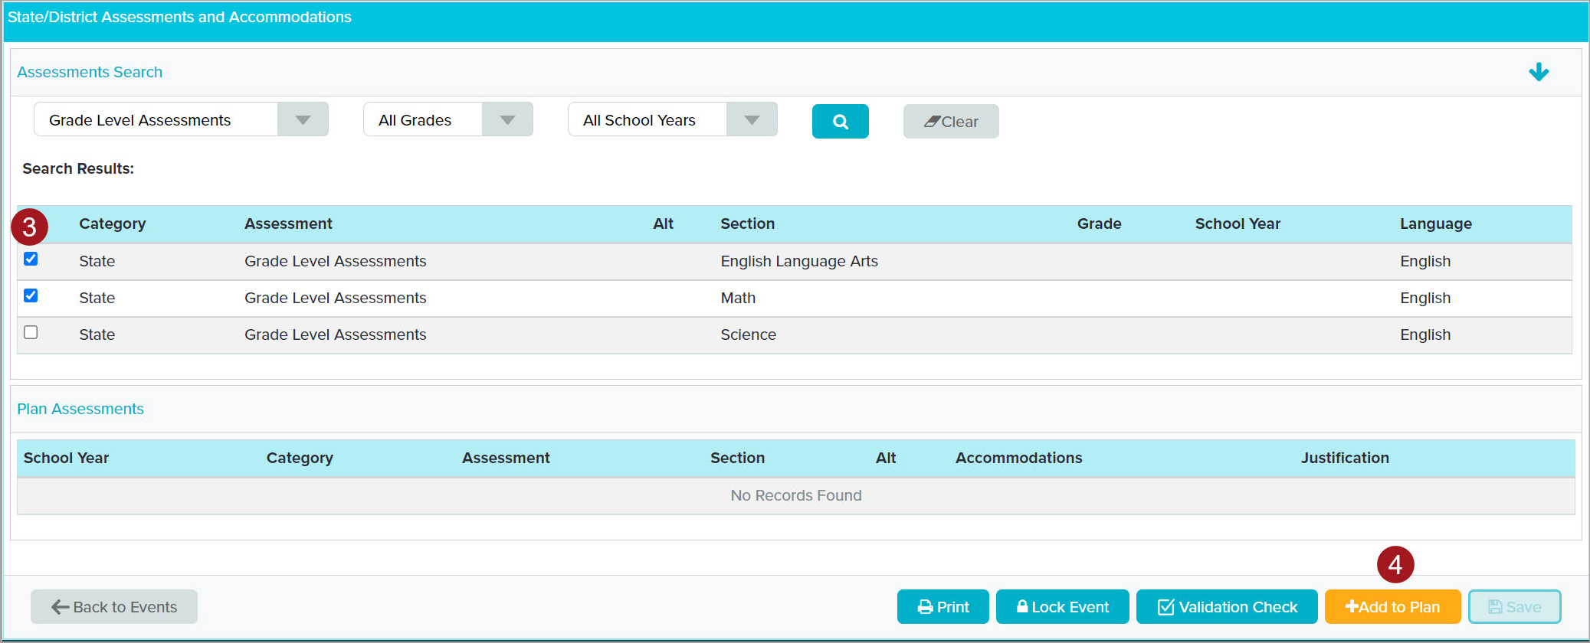
Assessments – Add to Plan
Choose the specific sections the student will take
Add to Plan
Add to Plan
Select the specific sections the student will take
Add to Plan
Tip: if the checkboxes are small on your screen making it difficult to select them, you can zoom your screen to increase the size. Select Control + or Command +
Reminder: Assessments are only added if the student will be using accommodations for the Grade Level, End of Course, NAEP, or ACCESS for ELLs assessments
Assessments are not entered on this screen if
The student will not be using accommodations for Grade Level, End of Course, NAEP, or Access for ELLs assessments
The student is eligible for MAP‐A
Reminder: Instructions for adding assessments appear on the Assessments Quick Start Card (Form D side)

Slide 58
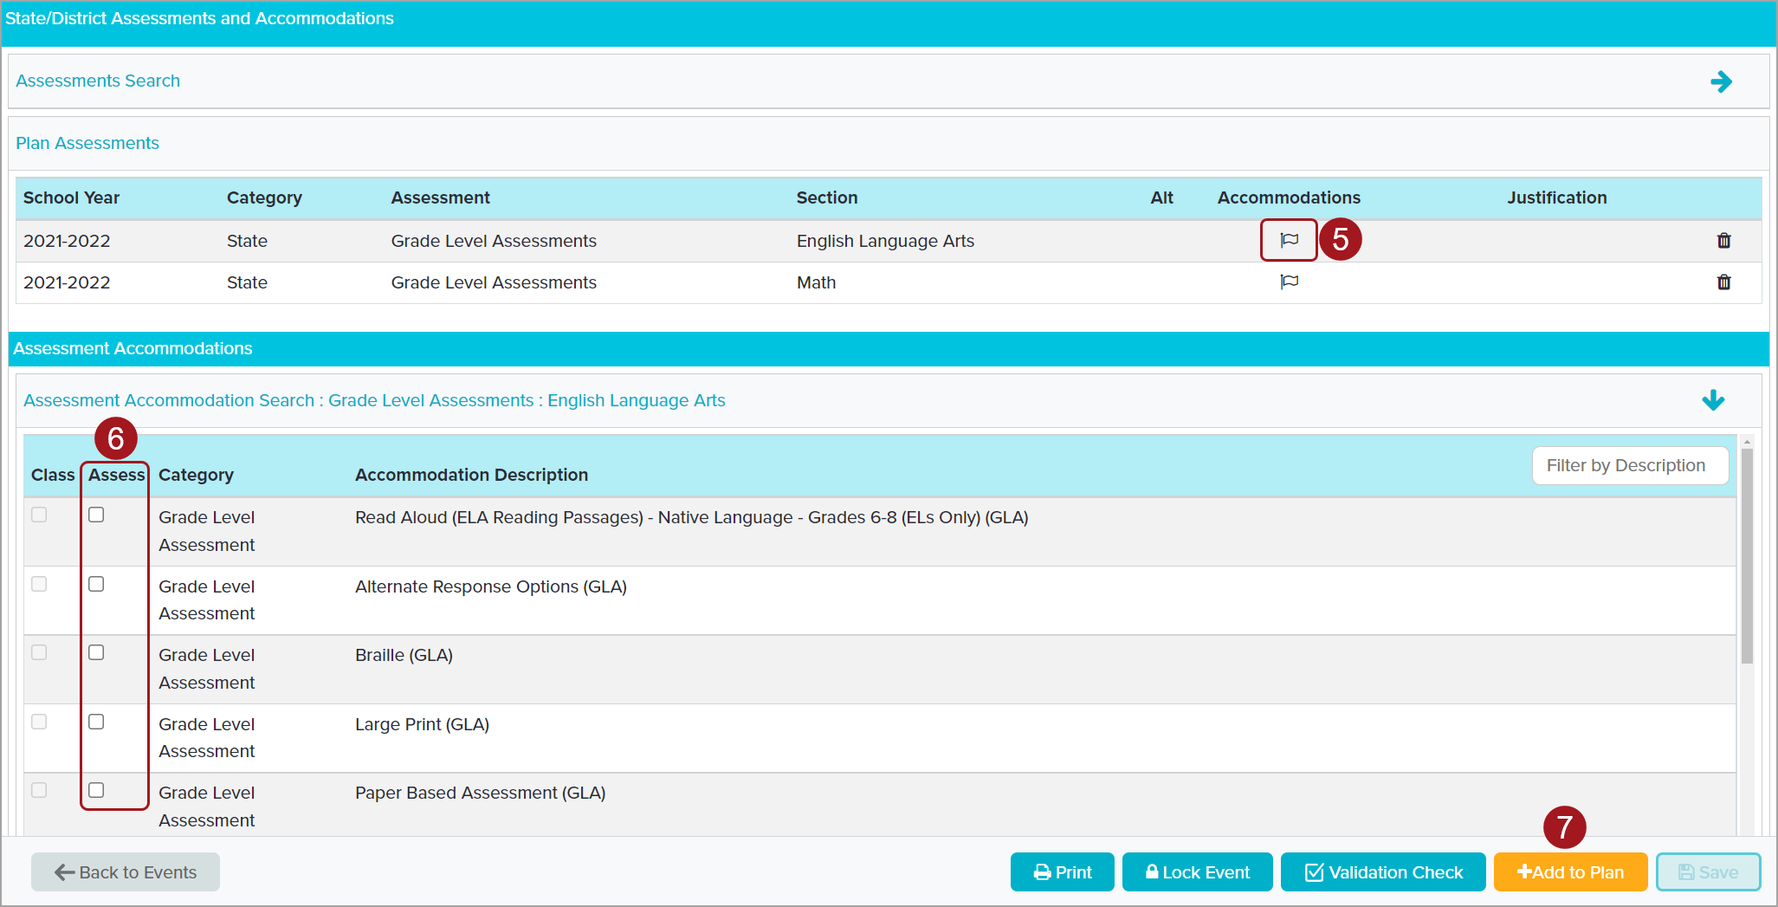
Assessments – Add Accommodations
Select the flag for the assessment
Select the accommodations
7. Add to Plan
Add Accommodations to Plan
Select the flag for the section. The Accommodations section opens displaying the accommodations for the selected assessment.
Select the accommodations
Add to Plan
Tip: if the checkboxes are small on your screen making it difficult to select them, you can zoom your screen to increase the size. Select Control + or Command +

Slide 59
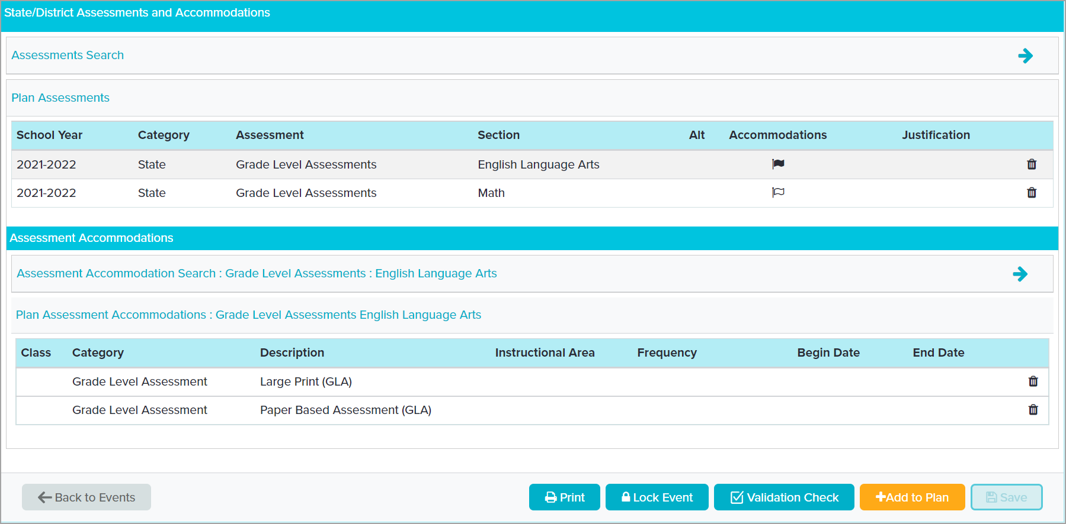
Assessments – Editing
Add new Assessment
Add additional Accommodations
The flag is filled when accommodations are saved
Click the flag to display saved accommodations
To delete accommodations or assessments, select the delete icon
Editing Assessments and Accommodations
The flag is filled when accommodations have been added to the plan
Hover over the flag to display a screen tip list of saved accommodations
Click the flag to display a list of the saved accommodations
To delete an accommodation or assessment, select the delete icon (the trash can)
If an assessment is deleted, all accommodations associated with it are also deleted.
To add new assessments
Select the arrow on Assessment Search
Follow the steps covered earlier
To add new accommodations
Select the flag for the assessment
Select the arrow on Assessment Accommodation Search to display the list
Follow the steps covered earlier
Tip: if the arrows are small on your screen making it difficult to select them, you can zoom your screen to increase the size. Select Control + or Command +

Slide 60
Classroom Accommodations– Select Accommodation Category
Accommodations for Alternate Form F are entered on the Classroom Accommodations Screen
1. Select a Category or select All
Classroom Accommodations
Classroom Accommodations and Modifications are entered on the Classroom Accommodations screen and print on Alternate Form F, a print only form.
Open the Classroom Accommodations Screen
1. Select a category or select "All"

Slide 61
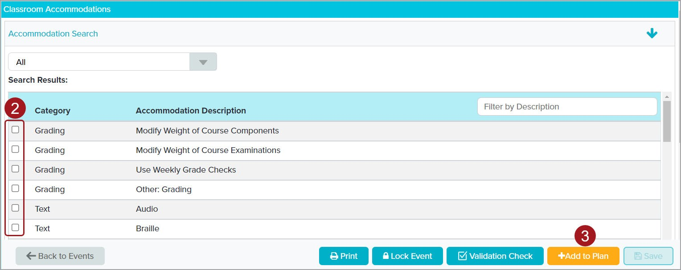
Classroom Accommodations – Select Accommodations
Select each accommodation required
Add to Plan
Select Accommodations
The accommodations display in Search Results.
Select the accommodations.
Add to Plan.
Tip: if the checkboxes are small on your screen making it difficult to select them, you can zoom your screen to increase the size. Select Control + or Command +

Slide 62
Classroom Accommodations – Enter Accommodation Details
Selected accommodations appear on "Plan Classroom Accommodations"
Accommodations are grouped by Category
Accommodation Details
The selected accommodations appear on "Plan Classroom Accommodations" grouped by Category. Each classroom accommodation has 4 required parts:
The accommodation
Instructional Areas (called "Location" on DESE Form F)
Frequency
Begin/End Dates

Slide 63
Enter Accommodation Details – Instructional Areas
4. Click Select to choose Instructional areas
Accommodation Details – Instructional Areas
4. Click Select to open the Instructional Areas window.

Slide 64
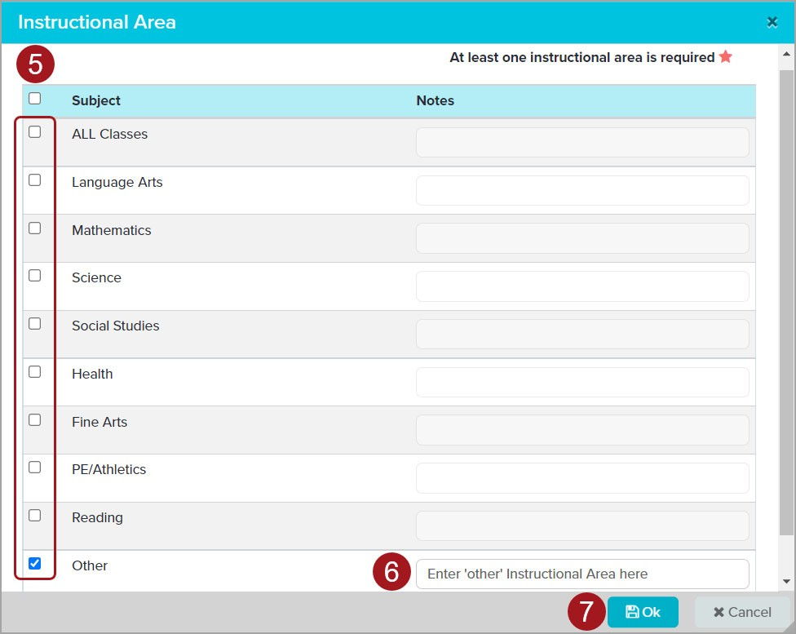
Choose Instructional Areas
Select the Instructional Areas where the accommodation will be used
Must select one, can select multiple
If "Other" is selected enter text in Notes field
Click OK
Select Instructional Areas
Select the Instructional Areas where this accommodation will be used.
It is best not to select the checkbox at the top of the list. This selects every option which prints as a lengthy list on Form F and likely includes classes the student is not taking. If the student truly will use this accommodation in every class, it is best to select "ALL Classes".
At least one is required. Multiple areas can be selected.
It is important to carefully consider where an accommodation is needed. "ALL Classes" can be selected but should only be used if the accommodation will really be used in every class.
If "Other" is selected, enter the specific area in the Notes field. This is not required by Phoenix but is required by DESE and provides the correct information to the parent.
When the appropriate areas have been selected, click OK.
Tip: if the checkboxes are small on your screen making it difficult to select them, you can zoom your screen to increase the size. Select Control + or Command +

Slide 65
Enter Accommodation Details – Frequency
8. Click Select link to choose Frequency
Accommodation Details ‐ Frequency
8. Click the "Select" link to open the Frequency window.

Slide 66
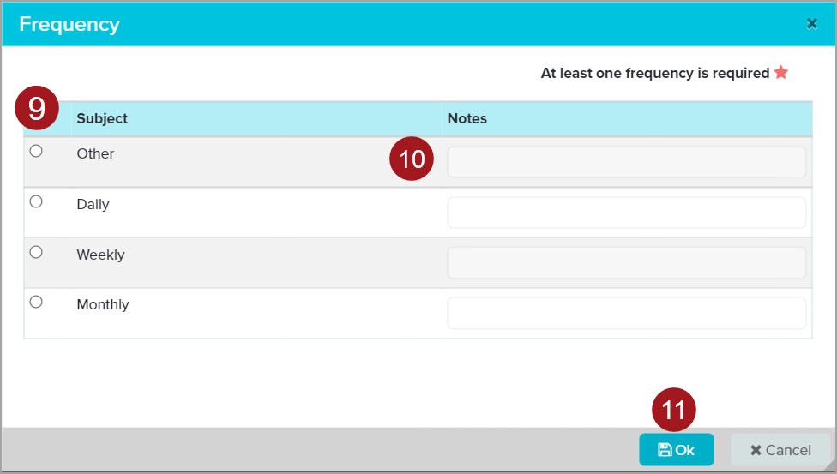
Select Frequency
Select one option
If "Other" is selected enter specific frequency in Notes
Click OK
Select Frequency
Select one option
If "Other" is selected enter the specific frequency in the Notes field. This is not required by Phoenix but is required by DESE and provides the correct information to the parent.
Select OK to close the window.
Tip: if the radio buttons (the circles) are small on your screen making it difficult to select them, you can zoom your screen to increase the size. Select Control + or Command +

Slide 67
Finish Accommodation Details
Edit Begin and End Dates if necessary
Click the date to display a calendar and choose a new date
If "Other" was selected as an accommodation, enter the accommodation details in the text box
Accommodation Details – Dates
Start and End Dates fill from the Plan Dates form
Can be edited if needed
Click the date to open the calendar
Select the new date
The dates must be within the Plan Date range (between the Initiation Date and the IEP End Date)
If "Other" was selected as an accommodation, enter the specific accommodation in the text box. This is required.

Slide 68
Save / Delete Accommodations
After details have been completed, Save
Accommodations can be deleted by clicking the Delete icon
Save / Delete Accommodations
After the details have been entered, Save.
The accommodations can be saved even if all of the details have not been entered. The details must be complete before the IEP can be locked.
Accommodations can be deleted by selecting the Delete icon (the trash can). A confirmation window will open. Click Yes to confirm the delete.

Slide 69
Goals Screen
Goal form is print only
SSD does not use Goal Search – all goals are Custom Goals
Click + Custom Goal
Goals Screen
The goals entered on the Goals Screen print on the Goals form (a print only form). SSD does not use the Goal Search. All SSD goals are Custom Goals.
1. Select +Custom Goal

Slide 70
Goals – Choose Domain/Area of Concern
Select the Domain
Select Area of Concern
Enter unique goal name
5. Add to Plan
Entering a Goal
Select the Domain
Select the Area of Concern (AOC)
Enter a unique/meaningful Goal Name
Every goal name must be unique and should be meaningful. The Goal Name does not print on the Goal Page but does on the Progress Report. It also appears on other screens throughout the program and on reports. A meaningful name will help when completing progress reports.
Add to Plan

Slide 71
Goals – Plan Goals
Goal appears on the Plan Goals list
To add additional goals, click + Custom Goal
When ready to complete the goal details click in the row
Goals – Plan Goals
The goal appears on the Plan Goals list
Add additional goals by clicking +Custom Goal and repeating the previous steps
When ready to complete the details for a goal, click in the row

Slide 72
Goals – Enter Goal Details
Type or paste goal text here
Enter Goal Text in the large text box
Edit Dates if necessary
Assign Responsible Staff
Select Measure
Enter Goal Details
The Goal Details panel opens
Enter the goal into the Goal Text box
Can copy/paste from another document or website such as Goalbook – remember to right click in the text box and paste as plain text, especially if copying from Goalbook
Edit the Dates if necessary
These dates auto fill from the Plan Dates form
They can be edited but must be within the Plan Date Range (between the Initiation Date and IEP End Date)
At least one goal must start on the IEP Initiation Date and at least one must end on the IEP End Date (from the Plan Dates) – doesn’t have to be one goal, can be one that starts on the Initiation Date and a different one that ends on the End Date (this is not common with goals)
If the Plan Dates are changed and saved, the matching dates here will automatically update
Assign Responsible Staff – this is the person who will be responsible for completing the progress report. The field is not required but all active goals must have a provider assigned for district data. If the goal is starting on the Initiation Date, it is easier to assign the provider here than after the IEP is locked.
Select the Measure
The measure should be consistent with the goal.
If the goal is measured in percent, the measure should be percent. For example, Johnny will do a skill with 80% accuracy. The measure would be Curriculum Based Measure‐ Percent, not Curriculum Based Measures‐Occurrence, or Whole Number, etc.
The measure type selected (percent, occurrence, whole number. etc.) determines the symbol that prints after the score on the progress reports (%, x/y, #, etc.)

Slide 73
Goals – Goal Details
Enter Baseline and Target scores
Enter Baseline Narrative text
Click Select link to choose Evaluation Criteria
Type or paste Baseline Narrative text here
Enter Goal Details
Enter Baseline and Target scores
The numbers entered can be zeros and can be decimals up to the tenths place.
NOTE: Baseline and Target scores can be entered up to 3 decimal places but only one number prints
Enter Baseline Narrative text – can be pasted (as plain text)
Click the Select link to open the Evaluation Criteria window

Slide 74
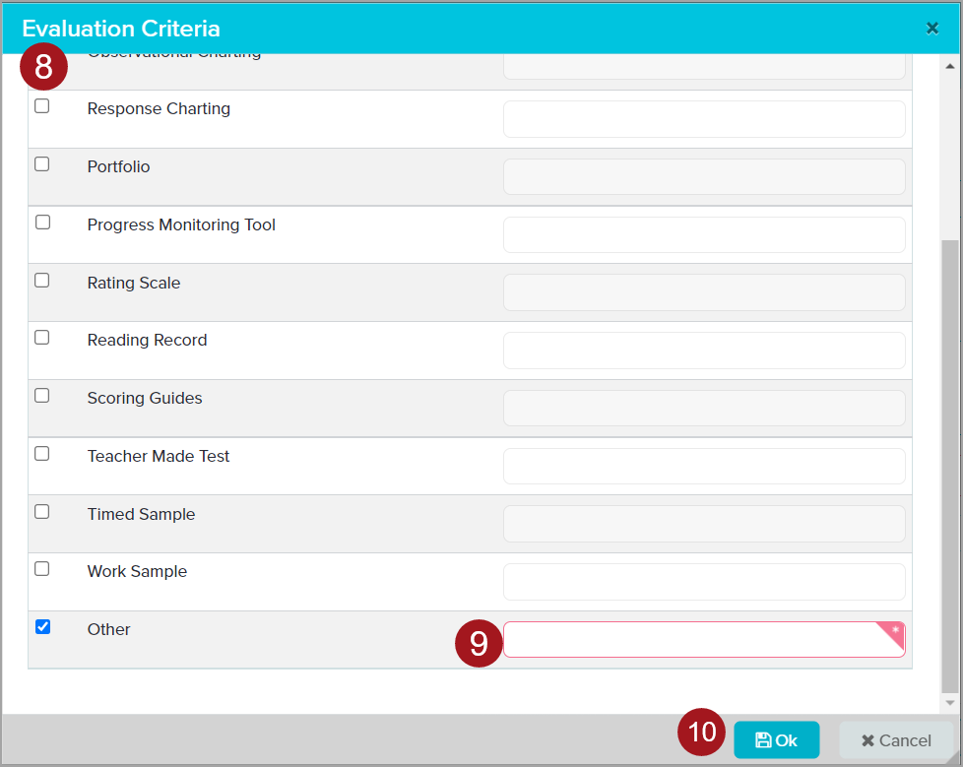
Goals – Choose Evaluation Criteria
Select at least one
Multiple can be selected
If "Other" is selected, enter the specific criterion in the Notes field
Click OK
Goals – Evaluation Criteria
Select at least one option – multiple can be selected
If you choose "Other" enter the specific criterion in the required Notes field
When you have selected all desired options, click OK
The window closes
Tip: if the checkboxes are small on your screen making it difficult to select them, you can zoom your screen to increase the size. Select Control + or Command +

Slide 75
Goals – Goal Details
If the goal supports a post‐secondary goal, check the box
Select the appropriate area or areas from the menu
If the goal will be addressed during ESY, check the ESY box
The statement prints on the goal page
Enter Goal Details – Post‐secondary and ESY
If the student has a post‐secondary transition plan (Form C), and this goal supports one or more of the post‐secondary goals, check the box.
Select the appropriate area/s from the menu.
If the goal will be addressed during ESY, check the ESY box
The statement prints on the goal page of the IEP
If the student is eligible for ESY the box must be checked for at least one goal. If none are selected, an amendment or correction must be completed.
Tip: if the checkboxes are small on your screen making it difficult to select them, you can zoom your screen to increase the size. Select Control + or Command +

Slide 76
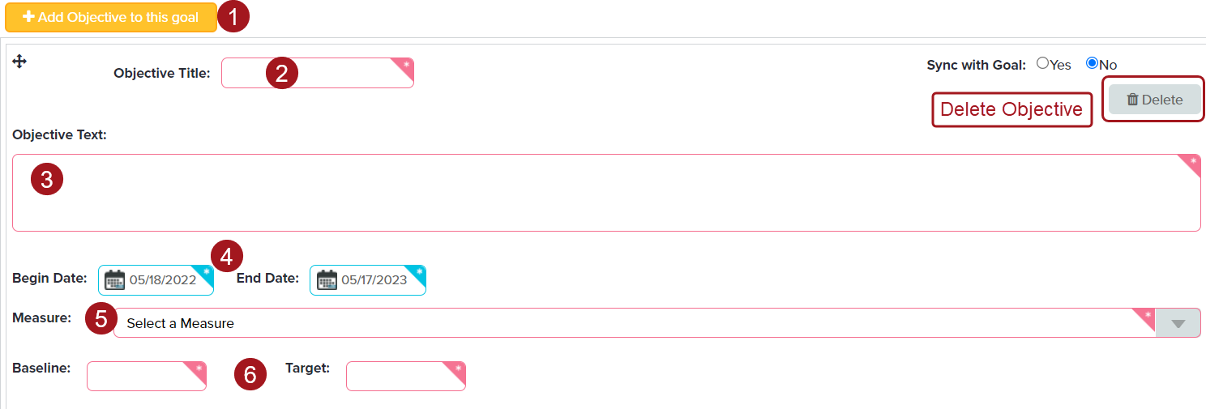
Goals – Adding Objectives
Click +Add Objective to this goal
Enter Objective Title – usually a number or letter
Enter Objective Text
Edit Dates if necessary
Select Measure
Enter Baseline and Target scores
Adding Objectives
Objectives are added only for students participating in an alternative state assessment (MAP‐A)
Click "+Add Objective to this Goal"
Enter the Objective Title – this is usually just a number or a letter
Enter the Objective Text – can be pasted by right clicking in the text field and choosing "paste as plain text"
Edit the Dates if necessary
Select a Measure from the menu
Enter Baseline and Target scores
NOTE: Because the "Sync with Goal" feature does not always work as designed it is best not to use it.
To add another objective, click the +Add Objective to this Goal button again and follow the above steps. It may be necessary to scroll to see the new objective.
To delete an objective, select the Delete button.
Objectives print in the order they appear on the screen (sorted by begin date or in the order entered if the begin dates are the same). Like the goals, the objectives can be moved by using the drag and drop feature. Grab the cross icon, drag the objective into the correct place in the order, then drop it.

Slide 77
Goals – Progress Reporting Section
Progress Reporting section is complete
Do not make changes
Goals – Progress Reporting Section
The Progress Reporting section of the goal is complete and should not be changed.

Slide 78
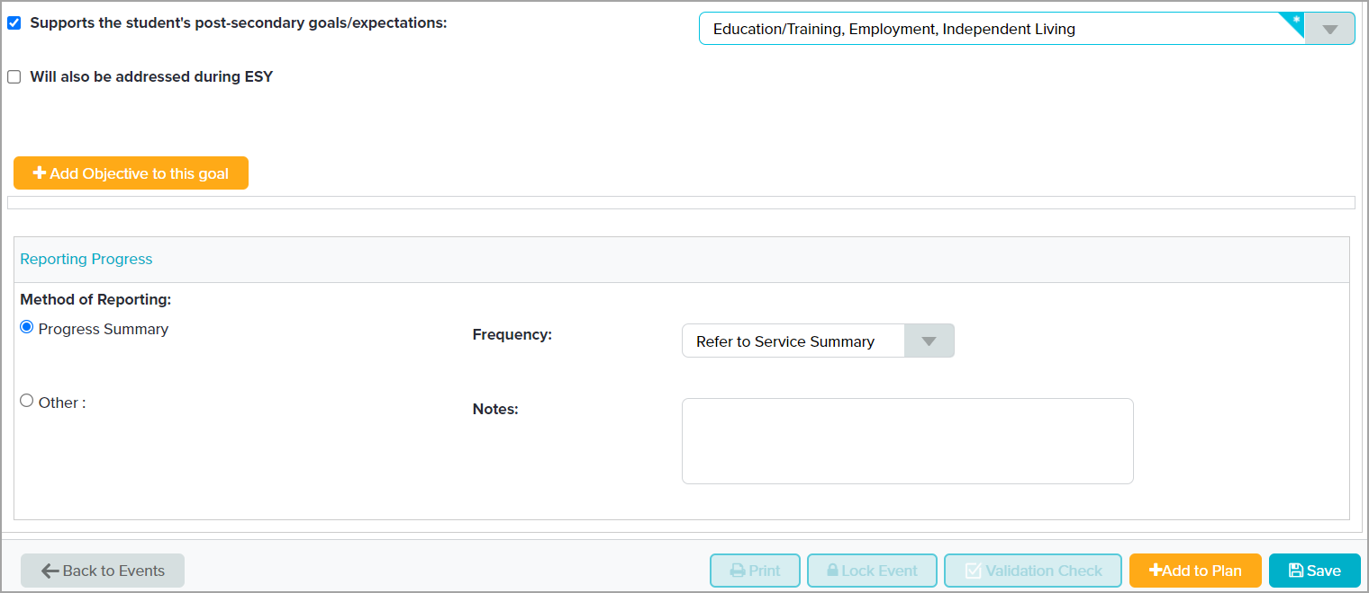
Goals – Save Goal
When goal details have been entered, Save
Goals – Save Goal
When goal details have been entered, Save.
A goal can be saved even if all of the details have not been entered. The details must be complete before the IEP can be locked.

Slide 79
Reordering Goals
Goals print in the order they appear on the Plan Goals panel, but the order can be changed
Click and hold the cross icon for the goal you wish to move
Drag the goal to the desired location and drop it
Reordering Goals
The goals print in the order they were entered and appear on the Plan Goals list. However, they can be rearranged to print in the order you want using drag and drop.
Click and hold the cross icon to grab it
Drag the goal to the desired location
Drop it
The change saves automatically

Slide 80
Deleting Goals
Goals can be deleted before an IEP is locked and from a Correction if no progress reports have been completed
Click the Delete icon
Goals – Deleting a Goal
Goals can be deleted from an IEP before it is locked and from a Correction event. However, a goal should never be deleted from an Amendment or if any progress reports have been completed for it.
If progress reports have been completed but the goal will no longer be addressed, change the End Date to the last date the goal was/will be addressed. This will ensure all completed progress reports are saved and no further reports are created for the goal (progress reports are created for active goals only).
In a Correction, if the goal was never addressed and no progress reports have been completed, it can be deleted. To delete a goal, select the Delete icon.

Slide 81
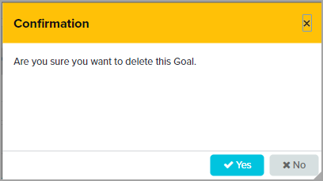
Confirm Delete
Click "Yes" to confirm the delete
Confirm Delete
The Confirmation window opens. Select Yes to confirm the delete.
Pressing “Enter” on your keyboard will close the window but not delete the goal. “Yes” must be clicked to delete the goal.

Slide 82
Services Screen – Add Multiple Services
Check the Servicing School – this is the current school
School Year Service is selected
Select Service Group
Click Search icon
Services Screen ‐ Add Multiple Services
Services are entered on the Services screen and print on the Services Summary form. It is possible to select and add multiple services to the plan at the same time.
Check the Servicing School at the top
This should be the student’s current school
Autofills on all new services
The system uses this school to calculate the LRE (Least Restrictive Environment – Placement)
If it is not correct, select the correct school from the drop down
Select the correct Service Group Type
School Year Service – for services provided during the regular school year. This is the default setting
ESY Services – for services to be provided during ESY. If the student is eligible for ESY at least one service must be entered in this category. Phoenix will not require it, but it is required by DESE and SSD.
Post‐Secondary – not used by SSD
Select the Service Group
Special Education – every student must have at least one Special Education service
Related Services
Supplementary Aids and Services
Supports for School Personnel
Click the Search icon

Slide 83
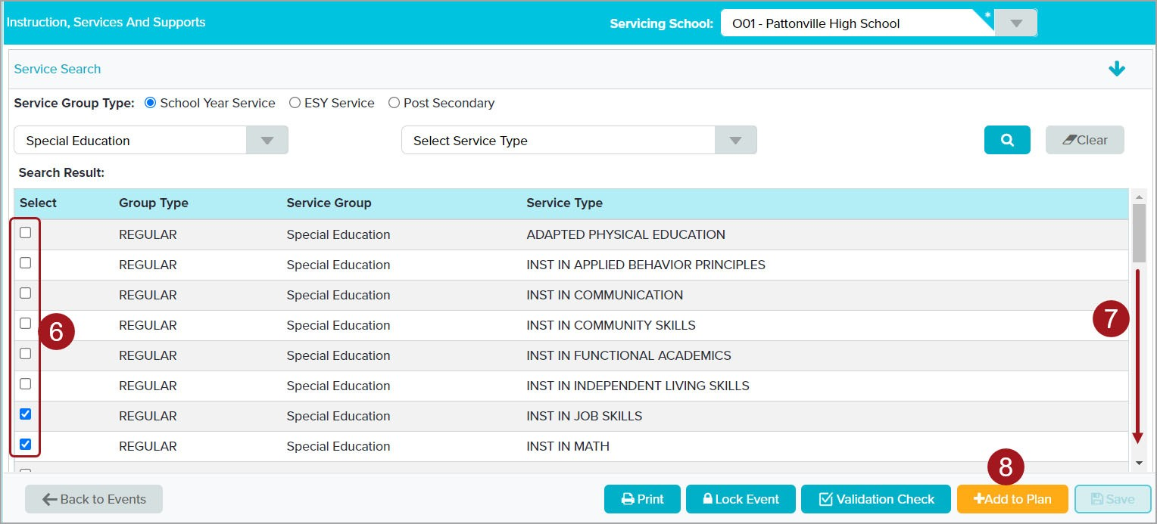
Services Screen – Select Multiple Services
Select the desired services
Scroll to see additional services on the list
Add to Plan
Services Screen ‐ Select Multiple Services
Select the desired services
The list continues below. Scroll to view and select additional services.
Add to Plan
All services are added to the Plan Services table.
When a service is chosen that was previously added, a message may pop up confirming you want to enter the same service again. If you do, click Yes. If you don’t, click No.
The list includes services for the selected Service Group only. To add additional services, repeat the steps.

Slide 84
Services Screen – Add One Service
Check the Servicing School – this is the current school
School Year Service is selected
Select Service Group
Select Service Type
Click Search icon
Services Screen ‐ Add One Service
Services are entered on the Services screen and print on the Services Summary form.
Services can be added to the plan one at a time or multiple at once. These steps are to add one service.
Check the Servicing School at the top
This should be the student’s current school
Autofills on all new services
The system uses this school to calculate the LRE (Least Restrictive Environment – Placement)
If it is not correct, select the correct school from the drop down
Select the correct Service Group Type
School Year Service – for services provided during the regular school year. This is the default setting
ESY Services – for services to be provided during ESY. If the student is eligible for ESY at least one service must be entered in this category. Phoenix will not require it, but it is required by DESE and SSD.
Post‐Secondary – not used by SSD
Select the Service Group
Special Education – every student must have at least one Special Education service
Related Services
Supplementary Aids and Services
Supports for School Personnel
Select Service Type
Options will vary based on selection made for Service Group
Click the Search icon

Slide 85
Services – Select Service
Select the Service
Add to Plan
Select Service
The selected service appears in Search Result
Select the Service – click the box in front of the name of the service
Add to Plan
The selected service is added to the Plan Services table.
When a service is chosen that was previously added, a message may pop up confirming you want to enter the same service again. If you do, click Yes. If you don’t, click No.
Tip: if the box is small on your screen making it difficult to select, you can zoom your screen to increase the size. Select Control + or Command +

Slide 86
Services on Plan Services
The selected services appear on Plan Services
Click in a row to open Service Details
Services on Plan Services
The selected services are added to the Plan Services panel.
If a specific service is needed more than once, for example the student will receive Instruction in Math in both the Special Education and Regular Education settings, repeat the steps to add additional services.
When a service is chosen that was previously added, a message may pop up confirming you want to enter the same service again. If you do, click Yes. If you don’t, click No.
When ready to complete the details for a service, click in the row

Slide 87
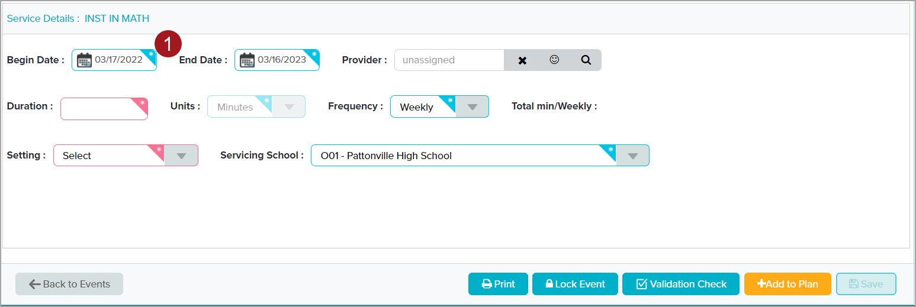
Services Screen – Service Details: Dates
Dates are prefilled from the Plan Date form but can be edited
At least one service must start on the IEP Initiation Date
At least one service must end on the IEP End Date
Revise the dates for transitioning students and ESY services
To change the dates, click the calendar icon and choose the new date from the calendar that opens
Service Detail Window – Service Dates
Begin and End Dates are prefilled with the Plan Dates
Can be edited here if the service either starts or ends at a different time than the IEP
Must be within the Plan Date Range (between the Initiation Date and IEP End Date)
At least one service must begin on the IEP Initiation Date and at least one must end on the IEP End Date (from Plan Dates). It doesn’t have to be one service, it can be different services.
Pay particular attention to the dates when entering services for students transitioning from one school to another (such as moving from elementary to middle school or middle school to high school).
Enter two separate sets of services, one for each school/school year. The services for the current school/school year must all end on the same day then the services for the new school/school year must start the next day.
Check the dates carefully to avoid errors when the LRE (placement) is calculated
There should be no gap between the end of services for one year and the start of services for the next (use consecutive dates)
This would cause an incorrect placement to be calculated for the time between the school years
The dates of the services should not overlap
All services for the first year should end the day before services for the next year begin
Overlap causes the amount of service to be doubled when the new services begin
LRE will be incorrect
A service can continue for both years but if the Servicing School will be different for the second year, the service must be entered twice
Note for High school teachers: At least one service must continue to the end of the IEP even if the student is graduating.
When the student graduates or ages out the Student Data Secretary will exit the student from Phoenix
Once students graduate, they are no longer eligible to receive special education services

Slide 88
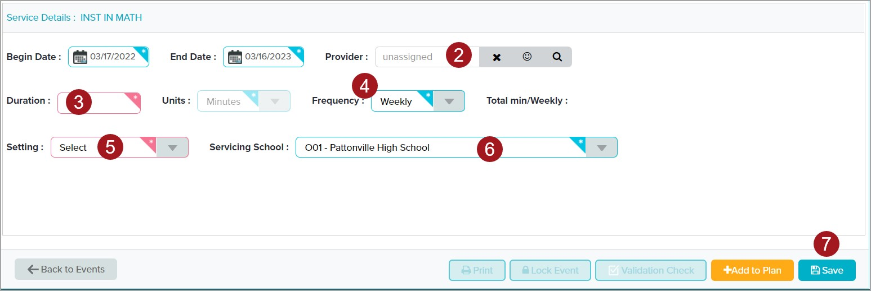
Services Screen – Service Details
Assign Provider, if known
Enter Duration
Select Frequency
Select Setting
Check Servicing School – school where THIS service will be provided
Save
Service Detail Window – Complete Service Details
Assign the Provider, if known
If the service starts on the Initiation Date it is easiest to do it here
Enter Duration – the minutes of service to be provided
Select Frequency
Weekly is the default
Monthly is an option
Select Setting
Special Ed
Regular Ed
Home ECSE – for Early Childhood only
Servicing School – autofills with the Servicing School from the top of the screen
This is the school where THIS service will be provided
If the student is transitioning (such as from middle school to high school) this would be the current school (middle school) for the first set of services and the new school (high school) for the second set of services. This ensures the LRE is calculated correctly for each school.
When details have been entered, Save
A service can be saved even if all of the details have not been entered. The details must be complete before the IEP can be locked.

Slide 89
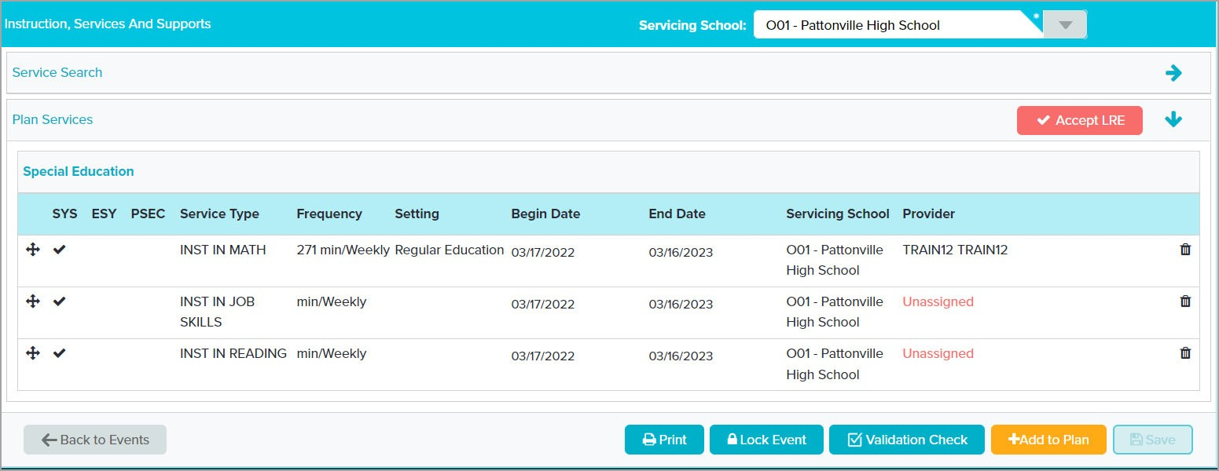
Services – Plan Services
After saving a service, the Accept LRE button appears
Accept LRE after ALL services have been finalized
Add new service by clicking arrow on Services Search
Add additional service
Plan Services
Each time a service is saved, the Accept LRE button appears. It does not have to be done after every service.
It is best practice to wait until ALL services have been entered and finalized before accepting the LRE. If any changes are made to services (service added, deleted, or changed) the Accept LRE button will reappear. It can be done just before locking. The event cannot be locked if the LRE has not been "accepted".
Clicking the Accept LRE button moves you to the Federal 4 Summary screen. This is where the LRE is actually "accepted". This will be covered later in this training.
To add a new service, click the arrow on Services Search and follow previous steps.

Slide 90
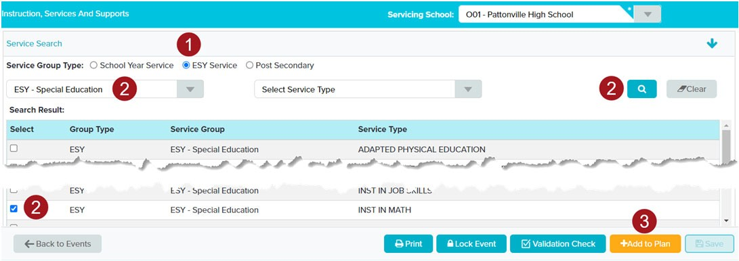
Services – ESY Services
ESY Services are entered on Services Screen and print on Form B
Select the ESY button
Search for and select the service/services
Add to Plan
ESY Services
It is important that the ESY Services are entered using the ESY Services option so they are not calculated in the placement and they print on Form B
Reminder: ESY Services are entered on the Services Screen and print on Form B To add an ESY Service
In Service Group Type, select ESY Services
Search for and select the service or services
Single or multiple services can be added
Add to Plan
When a service is chosen that was previously entered a message may pop up confirming you want to enter the same service again. Click Yes.

Slide 91
Services – ESY Details
Edit Begin and End Dates to match ESY dates
Enter all other details
Provider can be left unassigned
Servicing School can be left as current school
When all details have been added, Save
Enter the Details of the ESY Service
Begin and End Dates are filled from the Plan Dates screen
Begin and End Dates that autofill are for the length of the IEP – they must be changed to ESY dates
If the specific dates are not known at the time of the IEP or Amendment, enter the most accurate dates possible ‐ can be based on the ESY dates from the previous year
"ESY dates may be adjusted" prints on Form B
All dates must be within the Plan Date range (cannot enter a date after the expiration of the IEP)
If the current IEP expires before ESY, a new IEP must be completed – cannot do an Amendment
When editing the End Date be very careful to choose the correct year
The Provider can be left unassigned. The ESY staff should take care of it.
The Servicing School can be left as the student’s current school. It can be edited on Staff Management by the ESY staff if necessary.
When all details are complete, Save

Slide 92
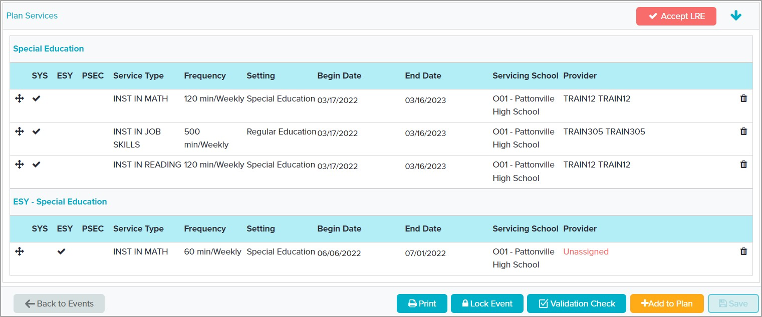
Services – ESY Services
ESY services appear on a separate list from School Year Services
ESY Services
After saving, the ESY services appear on a separate table from the School Year Services and are marked with a check in the ESY column.
Reminder: ESY services are not calculated into the student’s placement (LRE) so they must be entered using the appropriate Service Group and have the correct Begin and End Dates.

Slide 93
Reordering Services
The Services print in the order they appear on the screen – order can be changed
Select the cross icon to use the drag and drop feature
Services can only be moved within the same group
Changing the Print Order of the Services
The services print in the order they appear on the screen.
If a different print order is desired, they can be rearranged using the drag and drop feature.
Click and hold the cross icon to grab it.
Drag the service to the desired location
Drop it
The change saves automatically
Order can only be charged within a Service Group.

Slide 94
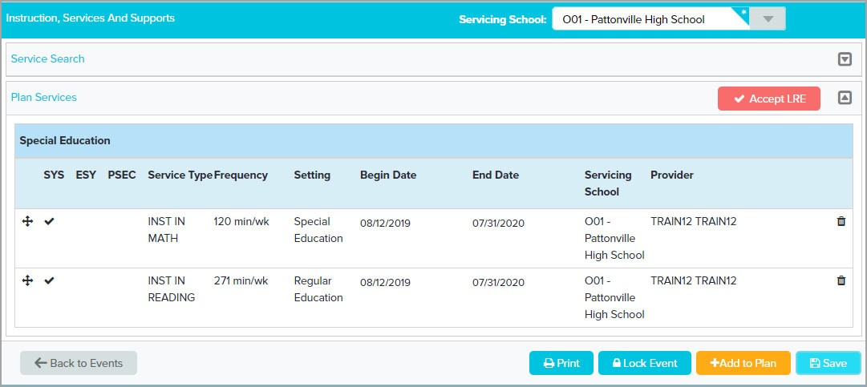
Deleting Services
Select the Delete icon to delete a service
Confirm the delete
Deleting Services
To delete a service
Select the Delete icon (the trash can)
The Confirmation window appears
Select Yes to confirm the delete
When a service is deleted, the "Accept LRE" button appears. The LRE must be "accepted" before the IEP is locked.

Slide 95
Accepting the LRE
After ALL services have been entered and finalized – click Accept LRE on Services screen
Accepting the LRE
After ALL services have been entered and finalized, click the Accept LRE button on the Services screen or go directly to the Federal 4 Summary.

Slide 96
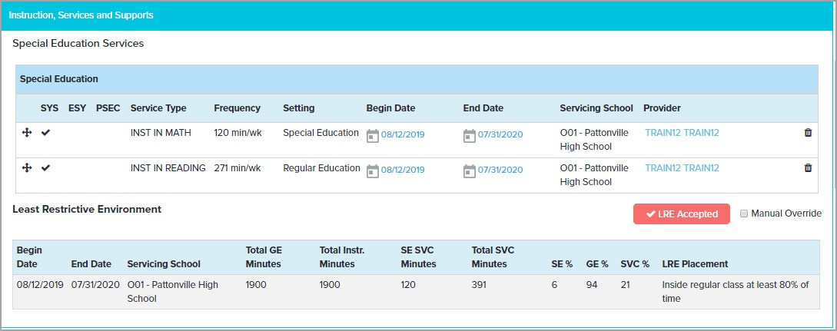
Federal 4 Summary – Accept LRE
Federal 4 Summary Screen opens
Click LRE Accepted button
The LRE must be "Accepted" in all IEP Amendment and IEP Correction events even if services were not changed
Federal 4 Summary – Accept the LRE
After clicking the Accept LRE button, the Federal 4 Summary screen opens. Review the information in the LRE section.
If services were entered with different start and end dates (such as for transitioning students) there will be multiple lines on the LRE table – one line for each time period
Gen Ed and Special Ed percentages are calculated for each time period entered on the Services Screen. Check the percents to be sure they make sense based on the student’s services
If something doesn’t look right ‐ such as special ed percent over 100 – go back to the Services Screen to double check dates and minutes (Duration)
Make note of the Special Ed and General Ed percents. For K‐12 students, they will be entered on the Placement Considerations form.
For K‐12 students, the LRE Placement category is prefilled based upon the GE % calculated after inputting services and the servicing school but can be changed using a Manual Override.
For EC students, the LRE Placement category is blank. A Manual Override must be done to select an EC placement category. Click in the Manual Override box then click Select to display the list of categories.
After reviewing the information, select the LRE Accepted button. The button is visible whenever the LRE must be accepted. The IEP cannot be locked if the LRE has not been accepted. The LRE Accepted button is not used for a Manual Override.
Note for ECSE and elementary: If the student will turn 6 during the IEP, the LRE screen will display one placement entry for the time the student is 5 and another that starts on the student’s 6th birthday. This is correct and cannot be changed.
Important: The placement calculated on this screen is what will be reported to the state and partner districts. It is extremely important this screen is accurate.
NOTE: The LRE must be "Accepted" in ALL IEP Amendment and IEP Correction events even if the services were not changed. Open the Federal 4 Summary and click the "LRE Accepted" button.

Slide 97
Overriding the Calculated LRE
Some LRE information can be changed by using the Manual Override
Manual Override is used to
Correct placement not based on percents
SSD Schools, Homebound, Early Childhood
Adjust minutes for part‐time students
Recalculates the LRE
Manual Override must be completed again in IEP Amendments and IEP Corrections– it does not copy
LRE‐Manual Override
The calculated LRE can be changed using the Manual Override. The Manual Override is used to
Correct placement when not based on percents – such as SSD Schools (Public separate school), Homebound (Home/Hospital) and Early Childhood (several options available – should match the option selected on the EC Placement Considerations page)
Adjust the Gen Ed and Instructional minutes (the building’s Instructional minutes per week) for part time students – LRE will calculate correctly (Total GE Mins must equal Total Instr. Mins)
Note: The instructional minutes for each school are based on the data provided by the state. They should only be changed if the student is attending part time.
The "Total GE Mins" and "Total Instr. Mins" fields must always be the same. If one is changed, either by the user or the system, the other must be changed so they match. This is for data and reporting accuracy.
Reminder: If Manual Override is used in an IEP, an IEP Amendment, or an IEP Correction, it must be redone for every Amendment or Correction done for that IEP. The system does not copy this information into the IEP Amendment or IEP Correction. This is particularly important for Early Childhood students and students in an SSD School.

Slide 98
Manually Updating LRE Placement
Check Manual Override box
Some fields become editable
Servicing School – should not need to be changed if dates are correct and schools were selected correctly on each service
Total GE Minutes and Total Instr. Minutes – change only if the student does not attend school full time – the two fields must match
LRE Placement – Placement Category which defaults to the category based on percent in general education
LRE – Manual Override – Updating LRE Placement category
To begin the Manual Override process, check the Manual Override box
The Servicing School is based on the school entered on each service on the Services screen. It should not need to be changed here.
Total General Education (GE) and Total Instructional (Instr.) Minutes are provided by DESE and should only be changed if the student does not attend school for a full day. If one is changed the other must be changed to match. They must be equal for data to calculate correctly (they are each used for separate data calculations).
LRE Placement
For K‐12 students: the category entered is based on percent in general education
For EC students: there is no category entered. A link to "Select" the correct category appears when the Manual Override box is checked. The link is used to display the list of options. Choose the appropriate EC option which should match the option selected on the EC Placement Considerations page.

Slide 99
Edit LRE Details
To edit the LRE Details
Servicing School: Click the current school and select the correct school from the list
Minutes: Click the minutes for each field. Enter new minutes in both text boxes. The two fields MUST be the same for data purposes.
LRE Placement: Click the current placement, or “Select”, and select the correct category from the list
Edit LRE Details
To change Servicing School, click the name of the current school then select the correct school from the list.
To edit the Total GE and Total Instr. Minutes, click the current minutes. A text box opens. Enter the new minutes in the box. Be sure to change BOTH fields. They MUST be the same for data to calculate correctly.
To correct the placement category, click the name of the current category, or "Select" for EC students, then choose the appropriate placement from the drop down.
School Age placements
Inside regular class at least 80% of time*
Inside regular class 40% to 79% of time*
Inside regular class less than 40% of time*
Public separate school (day) facility (Used for SSD Schools)
Private separate school (day) facility
Public residential facility
Private residential facility
Home/hospital (Homebound)
*Default based on the General Education percent
Early Childhood placements (can only be selected after checking the Manual Override box)
Early Childhood setting
Early Childhood special education setting
Home
Part‐time early childhood/Part‐time early childhood special education
Residential facility
Separate school
Itinerant

Slide 100
LRE Reminders
An error on the LRE is a result of errors on the Services screen
Error must be corrected on Services screen
Manual override is only used for
Placements not based on General Ed service percent
Students who attend less than full day
Early Childhood students
If manual override is used in an IEP, IEP Amendment, or IEP Correction, it must be redone in any IEP Amendment or IEP Correction completed for this IEP
LRE Reminders:
If there are errors in the dates or percentages on the LRE table it is because the information is not correct on the Services screen. The errors must be corrected on that screen.
Manual Override is only used for placements that are not based on the General Education service percent, students who attend school less than a full day, and Early Childhood students.
If a manual override is used for any reason in an IEP, IEP Amendment, or IEP Correction, it must be done again for any future Amendment or Correction of that IEP
You should always:
Confirm the "Total GE Mins" and "Total Instr. Mins" are equal
Check the General Ed and Special Ed percents to be sure they make sense based on the student’s services

Slide 101
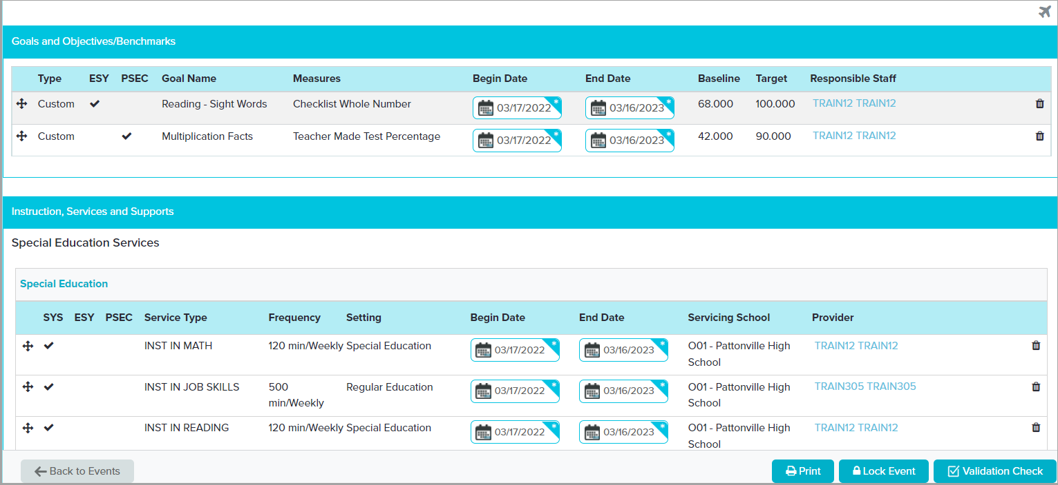
Federal 4 Summary – Goals and Services
Some fields are editable
Goals and Services can be reordered and deleted
Federal 4 Summary – Goals and Services
The Federal 4 Summary displays all goals, services, state assessments and accommodations, and classroom accommodations in the order they were entered in the IEP. It is a good place to review this information prior to locking the IEP.
In the Goals and Services sections, some fields are editable. You can change the Begin Date, End Date, and the Responsible Staff or Provider by clicking the link.
The goals and services can be reordered (print order) by using the drag and drop feature or deleted by clicking the trash can icon.
All other changes to the goals or services must be made on the screens.

Slide 102
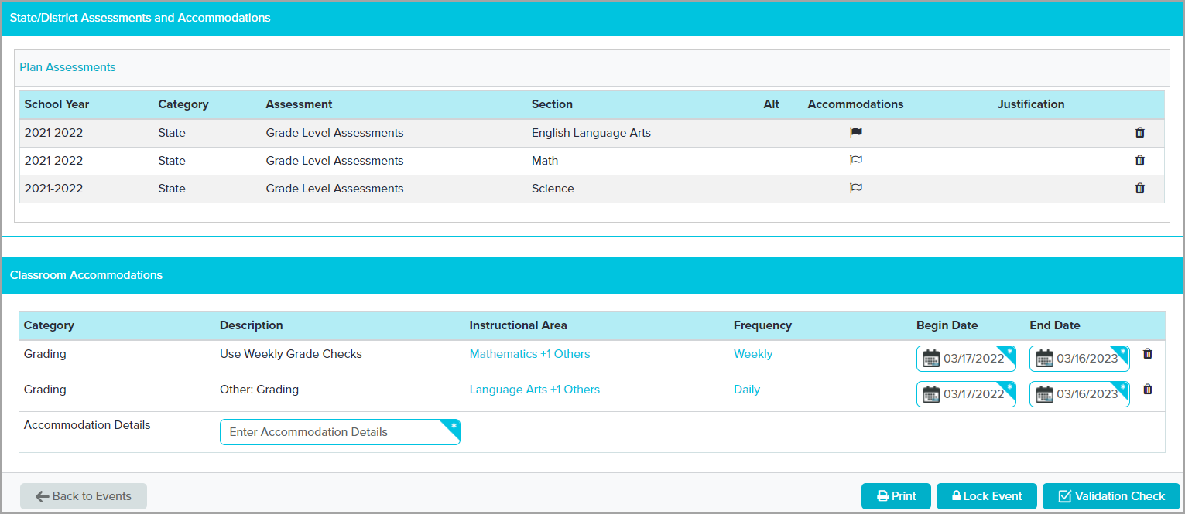
Federal 4 Summary – Assessments and Classroom Accommodations
View Assessment Accommodations by hovering over filled flag
Can edit some Classroom Accommodation fields and delete
Federal 4 Summary – Assessments and Classroom Accommodations
If Assessment Accommodations have been entered in the IEP, the accommodations flag is filled, and the accommodations can be viewed by hovering over the filled flag.
Classroom Accommodation details can be edited including Instructional Areas, Frequency, Begin Date, and End Date. Click the link and make the required changes.
Assessments, along with all accommodations selected for them, and Classroom Accommodations can be deleted by selecting the trash can icon.

Slide 103
Annual IEP – Services Summary
A
B C
School Year Services entered on Services Screen print on Services Summary
If EC Placement page is required select Yes at top
If Classroom Accommodations were entered, Documented on Alternate Form F must be selected or they will not print
Make a selection for Supports for School Personnel
Services Summary
Services entered on the Services screen print on this form above the Program Modifications and Accommodations section
If the student is between ages 2 and 6 and requires the ECSE placement form, select Yes at the top. If the student is age 7 or older this question is disabled.
Complete all required fields
Select how often progress will be reported – usually based on district’s reporting schedule but can be more frequent based on the IEP Team’s decision.
If student will use accommodations in the classroom (accommodations have been, or will be, entered on the Classroom Accommodations screen), select Documented on Alternate Form F (Classroom Accommodations). The Alternate Form F Decision form appears on the Forms List Panel and Overview.
Note: If "Documented on Alternate Form F" is not selected, the Alternate Form F Decision Form will not be created. Alternate Form F will not print, and no classroom accommodations will be included in the IEP even if they are selected on the Classroom Accommodations screen. This is one of the mistakes the Service Desk deals with frequently.
Note: Alternate Form F is a print only form. The accommodations are entered on the Classroom Accommodations screen.
If any Supports for School Personnel are entered on the Services Screen, choose "Documented Above"
Note: Supports for School Personnel are entered on Services Screen and print on the Services Summary
Save

Slide 104
Alternate Form F Decision
Used to indicate Alternate Form F should be printed
If this is not selected Classroom Accommodations entered will not be included in the IEP
Correction event must be completed
Alternate Form F Decision
Used to determine if Alternate Form F (classroom accommodations/modifications) should be printed.
Does not appear if "None" is selected in the Program Modifications and Accommodations section of the Services Summary
To print classroom accommodations/modifications, select Print Alternate Form F Save
Note: Alternate Form F will not print, even if accommodations have been entered on the Classroom Accommodations screen, if Alternate Form F Decision is not created and completed.
If you print the IEP and Form F is not included, it is usually because you marked "None" on the Services Summary. Return to the form and confirm you have selected "Documented on Alternate Form F"
Note: If this form has been created, completed and saved but is no longer needed, it can be reset so it is not included in the final, locked IEP. Instructions are on the "Resetting Forms in Phoenix" handout and in Phoenix Help.

Slide 105
Annual IEP – Services Summary Transportation
Answer transportation guiding questions
Indicate if student requires transportation
If student does require transportation
Complete transportation section
Transportation Decision Form is created
Services Summary – Transportation section
Answer the Transportation Guiding Questions
These questions must be answered
The responses selected have no impact on the ability to choose either option for transportation as a related service. This decision is made by the IEP team no matter how these questions are answered.
The questions do not print on the form – a copy of the questions is provided during training and can be downloaded from Phoenix Help
Indicate if student requires transportation as a related service If transportation as a related service is required
Complete the transportation section
The transportation decision form appears on the Forms List Panel and Overview

Slide 106
Transportation Decision Form
Indicates who is providing transportation
If SSD or Partner District is chosen, Transportation form is created
Neither forms print with the IEP
Transportation Decision
The decision form is used to determine if the Transportation form is needed
If Special School District or Partner District is chosen, the Transportation form is created and appears on the Forms List Panel and Overview
If any other option is selected, the Transportation form is not created
The Transportation Decision form and the Transportation form do not print with the IEP. They have a separate print layout used by the secretary to enter information into the transportation system.
Note: If this form has been created, completed and saved but is no longer needed, it can be reset so it is not included in the final, locked IEP. Instructions are on the "Resetting Forms in Phoenix" handout and in Phoenix Help.

Slide 107
Transportation Form
Use "Add" only for student who is not currently receiving transportation
Transportation accommodations do not appear on form
Must enter secretary’s email address – email sent when IEP, Amendment or Correction is locked
Does not print with IEP – has separate print layout
Transportation Form
Used for students who receive transportation as a related service when the transportation is provided by either SSD or the Partner district
Transportation Accommodations can only be viewed and edited on the Services Summary Form (they are an IEP team decision and can only be added or changed in an IEP or Amendment).
Choose the "Action"
"Add" is used for a student who is not currently receiving Transportation
"Review for changes" is used for all others, even if nothing is changing on the form
Enter your SSD administrator’s secretary’s email address on the form. This is the secretary who is responsible for entering the information in the transportation system.
The secretary will only receive one email – when the IEP, Amendment or Correction is locked.
It is very important if you are adding transportation for the first time for this student, or you are making changes to the form, that you call or email your secretary AS SOON AS the decision is made to add or change transportation. If you wait until the IEP is locked for the system to send the email it is possible transportation for the student will be delayed.
The Transportation Form is an internal SSD form. It is not included with the IEP when it is printed and is not provided to the parent. If you wish to print a copy of the form, choose "Transportation" from the Print Layout Chooser. This will print only the Transportation and Services Summary forms. Transportation accommodations print on Services Summary.
Note: If this form has been created, completed and saved but is no longer needed, it can be reset so it is not included in the final, locked IEP. Instructions are on the "Resetting Forms in Phoenix" handout and in Phoenix Help.

Slide 108
Annual IEP – Placement (K12)
When "No" is selected for 100% participation, the next section becomes required
Enter percentages from Federal 4 Summary
Complete reason full participation is not appropriate
Complete other required fields
Placement Continuum selection must match LRE on Federal 4 Summary
Placement Considerations for K‐12 (School Age) students
Three Placement forms are available on the Forms List Panel and Overview
First is required, the others are optional and used if the placement changes during this IEP
If the student is ECSE or in Kindergarten, six forms may appear – three for ECSE and 3 for K12 ‐ only one is required
Answer question about 100% participation in regular ed
If "YES" is selected the next section remains disabled
If "No" is selected the next section is required
Complete the statement with Regular and Special Ed percents as noted from the LRE section on the Federal 4 Summary (below the Services section)
Be sure to put the numbers in the correct fields – Regular Ed percent comes first on the form but second on the LRE table.
Complete the section explaining why 100% participation is not appropriate
Limited text field
If additional space is needed enter "See Additional Information page" and put the statement on the Additional Information page
Choose how student will participate in PE Select the placement category at the bottom
Check all that were considered by the team – must choose "At least 80%"
Click the one that was "Selected"
The "Selected" category at the bottom of the form must match the LRE on the LRE section of the Federal 4 Summary
Click Yes or No for the K‐12 section
If "No" is chosen, complete reason student is not at home school
Save

Slide 109
Annual IEP – Placement (EC)
When "No" is selected for services provided with non‐disabled peers, the next section is required
Enter number of Special Ed minutes from LRE section of Federal 4 Summary
Enter reason regular ed setting is not appropriate
Physical Education participation is printed on form
Placement Continuum selection must match LRE on Federal 4 Summary
Placement Considerations for Early Childhood students
Three ECSE Placement forms are available on the Forms List Panel and Overview. Depending on the student’s age, there may also be three K12 forms available. One of the forms is required. The others are optional and used if the placement changes during this IEP.
If the ECSE form is needed but does not appear, return to the Services Summary section and check "Yes" at the top (Does the student require an ECSE placement form?).
Answer question about extent of participation in regular ed
If "YES" is selected the next section remains disabled
If "No" is selected the next section is required
Enter the number of special ed minutes – you can find this number in the LRE section on the Federal 4 Summary screen (below the Services section)
Enter the reason the regular education setting is not appropriate for this student
Limited text field
If additional space is needed enter "See Additional Information page" and put the statement on the Additional Information page
The Participation in Regular Physical Education section is printed on the form
Select the appropriate placement category at the bottom. The category chosen at the bottom of the form must match the LRE Placement category selected on the LRE section of the Federal 4 Summary.
Save

Slide 110
Annual IEP – Prior Written Notice
The Prior Written Notice in all IEP events is specifically for IEPs
The options for proposed and refused actions are limited but "Other" is an option. Only one option can be chosen.
The text boxes expand
Five forms available inside IEP
Additional forms can be created in the Prior Written Notice Event
Prior Written Notice
Note: The PWN in all IEP/Amendment/Correction events is specifically for use in an IEP
Proposed or Refused options are limited but "Other" can be used if needed
Text boxes expand – no character limit
There are five PWNs available in the IEP
If additional forms are needed, a Prior Written Notice event can be created on the student"s Events page
Each Prior Written Notice event also has five PWNs
Multiple events can be created and can be open at the same time until the number needed is reached
Further instructions for creating additional PWNs are on the User Created Events Quick Start Card
PWNs do not copy into an IEP Amendment. New forms are completed for changes made in the Amendment (the original is stored in the locked IEP)
PWNs do copy into an IEP Correction.

Slide 111
Annual IEP – PWN Waiver
If parent waives the 10‐day waiting period
Click "Time requirement waived"
Select Written Waiver, Verbal Waiver or both
Complete required fields
Prior Written Notice – Waiver of 10 Day Period
Prior Written Notice must be provided to the parents for changes made to the IEP including type, amount or location of services, placement, goals, etc. (refer to chart provided during training and SSD Administrator for clarification). Legally, this notice must be provided at least ten days prior to the initiation of the action.
However, the ten‐day requirement may be waived by the parent/guardian/18+ year old student.
The waiver may be obtained in writing, verbally, or both. If the parent does not waive the 10 days, the begin dates in the IEP must reflect this.
If the parent does waive the 10 days, complete the waiver section at the bottom of the NOA.
Choose "Time requirement waived"
Next section becomes required
Choose "Written", "Verbal", or both
Appropriate section/sections are required
Complete the required fields depending on which section(s) is chosen
SAVE
All Prior Written Notice forms are "optional" in Phoenix. If a form is started and saved, it can be reset by selecting "Set Status to Not Modified" at the bottom of the form or by following the steps to reset forms found on the "Resetting Forms in Phoenix" handout and in Phoenix Help.

Slide 112
Additional Information Page
Blank page with unlimited character text box
Can be used for overflow from other pages
Sometimes used to include information required by DESE until Phoenix forms can be updated
Additional Information
The Additional Information page is a blank page that can be used for a variety of purposes.
If you run out of room on another form the rest of the information can be entered here. This is rare because most textboxes have unlimited characters but there are a few that are limited, such as on the placement pages.
Your SSD Administrator may direct you to add specific information on the Additional Information form.
Sometimes a change is made by DESE that cannot be addressed in Phoenix immediately. In this case you may be directed by your SSD Administrator to add something to the Additional Information page until the update to Phoenix is released.
Enter a Title for the form
Enter the information in the text field. This is an unlimited character field.
The Additional Information form is "optional" in Phoenix. If a form is started and saved, it can be reset by selecting "Set Status to Not Modified" at the bottom of the form or by following the steps to reset forms found on the "Resetting Forms in Phoenix" handout and in Phoenix Help.

Slide 113
Validation Check
Validation Check can be done anytime
Should always be done before locking to catch errors
Form Status is "Not Modified" until Validation Check is done
Click Validation Check
Validation Check
A Validation Check can be done at anytime on a form, screen, or on the Event Overview.
This checks each form and screen to be sure that all technically required fields have been completed. It does not check to be sure the content of the IEP is legally compliant.
The check can be completed at any time but should be completed prior to locking. If an attempt is made to lock an event with errors, the system will display the errors even if a Validation Check was not performed.
To complete the Validation Check from the Event Overview
Select Overview section at the top of the Forms List Panel
The "Form Status" at this point reflects the last time validation was checked or the event was opened. It will update when validation is checked again.
If you have completed some forms then closed and reopened the event, the status will be "NOT COMPLIANT" until the Validation Check is done.
Click the Validation Check button

Slide 114
If Event Fails Validation Check
Errors window opens
Use link to open form or screen and resolve errors
Contact Service Desk for assistance if needed
Return to Event Overview and select Validation Check
When validation check is successful, continue
Meeting is Not Compliant
If the meeting is not compliant, the Errors window displays
When the Validation Check is completed on the Event Overview the Errors window displays all errors causing the meeting to be noncompliant
Each entry shows where the error occurs
The name of the form or screen is a link. Selecting the link opens the form or screen where the error is located.
If you need help understanding or correcting an error, contact the Service Desk. The text in the Errors window can be copied then pasted into a ticket or email to the Service Desk.
Sometimes additional errors will appear after you address the first set. This is a result of how compliance is checked.

Slide 115
Resetting Unneeded Forms
Before locking be sure to Reset any forms that were created but are no longer needed – in this example the BIP will be reset
Return to form where the unneeded form was created (Special Considerations)
Change response to make form disappear from Forms List Panel (uncheck Behavior Intervention Plan)
Save
Resetting Unneeded Forms
Some errors may be a result of an unfinished form that is no longer needed – could be a "Hidden" form or an "Optional" form.
These forms can be reset if they are not needed.
Forms that were partially or totally completed then saved can be reset so they will not be included in the locked IEP. It is not necessary to delete information before resetting.
Instructions can be found on the "Resetting Forms in Phoenix" handout and in Phoenix Help. To reset a form
First you must reverse the steps that were taken to create it
In this example the BIP will be reset
Return to the form where the unneeded form was created (in this example Special Considerations)
Change the response that created the form (Uncheck the box in the behavior section)
Note: It is not necessary to remove the information from the form first
The form disappears from the Forms List Panel and Overview, but the process is not yet complete
If the process is not finished, the form will be included in the locked IEP
Save the form (Save Special Considerations)

Slide 116
Resetting Unneeded Forms, Cont"d
Return to the Overview
Select "Reset Optional Forms"
Reset Optional Forms
Return to the Overview to complete the process
The "Reset Optional Forms" button should be available at the bottom of the Overview. If it is not, return to the form where the unneeded form was created , reverse the choice that created the form and save.
Click Reset Optional Forms

Slide 117
Reset Optional Forms Window
Click the box for the form(s) you wish to reset
Click Save
The form will not be included in the locked event
Reset Optional Forms Window
The Reset Optional Forms window opens
Lists all forms available to be reset
A form only appears on the list if it is an "Optional" form or a "Hidden" form removed by changing the response that created it
If a form is not available to reset be sure the process that created it has been reversed (in this example, return to Special Considerations and uncheck the box for the BIP)
Check the box for each form to be reset
Save
NOTE: A form that has been reset can be used again if needed. Enter information on the form and Save. This will make the form active again.
NOTE: You may also contact the Service Desk for assistance with resetting unneeded forms.

Slide 118
Validation Check Successful
When all forms are compliant, the "Validation Successful" message displays briefly
All completed forms are Phoenix "COMPLIANT"
Validation Check Successful
After correcting all errors and resetting all unneeded forms, return to the Overview and select Validation Check. When the event is compliant a message displays briefly then disappears.
Status column shows
Green "COMPLIANT" for all forms where the required fields are compliant (all technically required fields complete)
Yellow "NOT COMPLIANT" (cannot lock event if any form/screen is not compliant)
"NOT MODIFIED" for any form that has no information entered or optional forms that were reset

Slide 119
Print and Proofread
When the validation check is successful, click Print
PDF will open – view on screen or print
PROOFREAD
Double check dates – Initiation, Goal and Service Start/End
If student is eligible for ESY
Form B includes ESY services with correct dates for ESY program
At least one goal displays ESY statement
If student has classroom accommodations, Form F is included
Make any necessary corrections or changes
Return to Event Overview
Print and Proofread Before Locking
Reminder: Events cannot be unlocked in Phoenix. To avoid the need for a correction event it is very important to proofread before locking.
When the meeting is compliant, select Print on the Overview screen
Printing can be done at anytime and from any form or screen. It is critical that it is done before locking.
The PDF will open in a new window or tab depending on browser setting
Can view the PDF on the screen or click the printer icon on the Adobe tool bar to print it on paper At this point most forms say "DRAFT" across them – exceptions:
Excusal
Transfer of Rights
Prior Written Notice
Double check
Initiation Date – shouldn’t be more than 10 days in the future (except for some situations in ECSE or possibly an Initial IEP when awaiting parent consent to provide services)
If student is ESY eligible, Form B shows ESY services and at least one Goal displays the ESY statement
If student is eligible for MAP‐A, Form D‐Part 3 is complete, and objectives are entered for goals
If student is, or will be 16 or older, Form C is complete, and goals are marked appropriately for Transition
Close the PDF window/tab

Slide 120
Lock Event
Click Lock Event
The Confirmation window appears
The Initiation Date should be within 10 days of the Meeting Date for an Annual IEP
If the date is not correct, or you are not ready to lock, click Cancel
To correct the Initiation Date return to Plan Dates
When Dates are correct, check the box and select OK
The IEP locks
Lock the IEP
Click Lock Event
If the IEP is not Compliant, error messages will appear. Errors must be corrected before the IEP can be locked.
If the IEP is Compliant, the confirmation message appears.
The Initiation Date and End Date of the IEP appear on the Confirmation window. Double check the dates.
If the dates are correct, click OK. The IEP will lock.
NOTE: For students in grades K – 12, the Initiation Date of an Annual IEP should be on, or no more than 10 days after, the IEP Meeting Date. Per DESE, no undue delay can occur in providing special education and related services to the child. If a delay is necessary, the reasons must be documented in the IEP.
If the dates are not correct, or you are not ready to lock, click Cancel. If necessary, return to the Plan Dates screen and correct the dates.
If the End Dates must be corrected, be sure to check the Begin Dates also. Likely they will need to be updated as well.
If the dates are changed the LRE must be "accepted" on the Federal 4 Summary before locking.
One final reminder: Once an Event is locked in Phoenix, it cannot be unlocked. Errors in a locked IEP can only be corrected by creating and completing an IEP Correction event.

Slide 121
Locked Annual IEP
Future IEP and Notification of Meeting
Locked IEP and NOM
Locked Annual IEP moves to Locked Events
Plan Status is "ACTIVE" or "PENDING ACTIVE" depending on Initiation Date
Completed On date is date the IEP was locked
Completed By is person who locked the IEP
Actual Date of Notification of Meeting is Date last NOM was "Stored"
Actual Date of Annual IEP is the Meeting Date
Future Annual IEP appears on Scheduled Events due in 364 days from Meeting Date of new IEP
Locked IEP on the Events screen
Locked Annual IEP is found on the Locked Events panel
Status will be
ACTIVE if the Initiation Date is the day the event is locked or earlier
PENDING ACTIVE if the Initiation Date is in the future. PENDING ACTIVE plans become ACTIVE on the Initiation Date of the IEP.
PENDING if this is an Initial IEP and the Parent Consent event has not been locked, regardless of Initiation Date
The "Completed On" date is the date the IEP was locked
"Completed By" is the person who locked the IEP
The "Actual Date" of the Notification of Meeting is the date "Create/Store Invite" was selected by the user for the last time, storing the final NOM
The "Actual Date" of the Annual IEP is the IEP Meeting Date
Future Annual IEP is created and appears on Current and Upcoming Events panel
Due 364 days from the Actual Date (Meeting Date) of the IEP that was just locked
Event Primary Staff is the person who locked the IEP

Slide 122
View or Print Locked IEP
To view or print the locked IEP on Locked Events panel
Click the hamburger icon
Hover over View
Select print layout from list
To view or print the locked IEP
Locate the event on the Locked Events panel
Click the Hamburger icon next to the event
Choose View from the list then choose the print layout The print layout choices are:
Annual IEP – opens the complete IEP
Transportation – opens the Services Summary and Transportation forms for use by secretaries entering information into the transportation system
Excusal – opens only the Excusal – can be printed separately if needed prior to the meeting (no DRAFT, can be printed before IEP is locked)
ESY – prints forms needed for ESY programming
PWN‐Only – opens only the Prior Written Notices – allows the Prior Written Notices to print separately for parent signature (no DRAFT, can be printed before IEP is locked)
Classroom Accommodations‐Only – opens only Alternate Form F allowing it to be printed separately from the rest of the IEP
The PDF is created in a new window or tab, depending on browser settings Use the PDF tool bar to print
Close the PDF window/tab.

Slide 123
Phoenix Support
Phoenix Help: Found within the site – click a Help Icon from the direct link, or from the Portal of SSD Life
SSD Help Center (Service Desk)
SSD Help Center tile on the portal
SSD Help Center web site: https://ssdmo.atlassian.net/servicedesk/customer/portal/4
Email to technologyservices@ssdmo.org creates a ticket
Phone calls (314‐989‐8686) are entered into ticket system by the Service Desk Staff as they are received
SEIMS Facilitators
Tracy Turner
Mary Spires
Phoenix Support
A reminder of resources available for support with Phoenix
The first place to go is Phoenix Help
Help Icon (the question mark) found on the Main Navigation Menu
Help icon on all event and form pages and screens
SSD Life > SSD Portal > Phoenix Help
Directly by using the web address: https://ssdmo.atlassian.net/wiki/x/OoBmAw
The Service Desk is available from 7 AM until 4:30 PM
Create a ticket in the Service Desk portal through SSD Life > SSD Portal > SSD Service Desk or by using the Service Desk Portal web address: hhttps://ssdmo.atlassian.net/servicedesk/customer/portal/4
Send request in an email which automatically creates a ticket
Call 314‐989‐8686 – voice mail creates ticket
Be sure to include your name plus the student’s name and SSD Student Number along with a brief description of the issue
Include phone number and the best time to call if you would like a call back
You will receive an email with the ticket information. Please use the ticket to communicate with the Service Desk. Only create one ticket per issue.
SEIMS Facilitators
Tracy Turner – 314‐989‐8586 – tfturner@ssdmo.org
Mary Spires – 314‐989‐8558 – mspires@ssdmo.org

