Slide 1
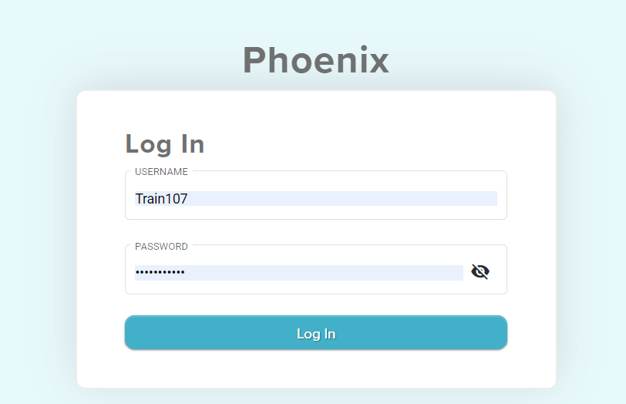
Log into Phoenix using https://phoenix.ssdmo.org
You will use your regular username and password for this, but not all portions, of this training.

Slide 3
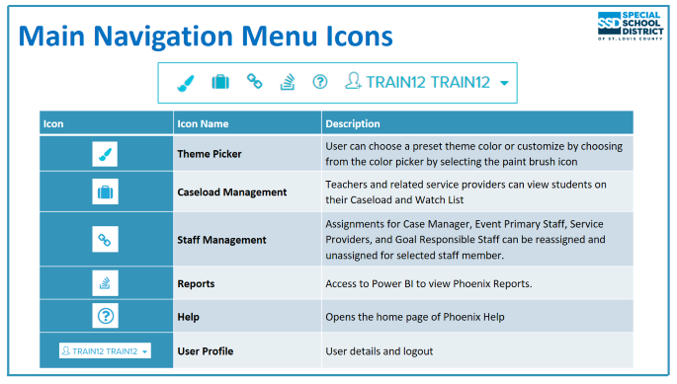

Slide 4
Searching for Students
Simple Student Search​
Enter student's Last Name, SSD Student ID, or MOSIS ID​
Click the Search icon or press Enter on your keyboard​
Results display on Student List panel​
Click the student's name to open the Student Profile

Slide 5
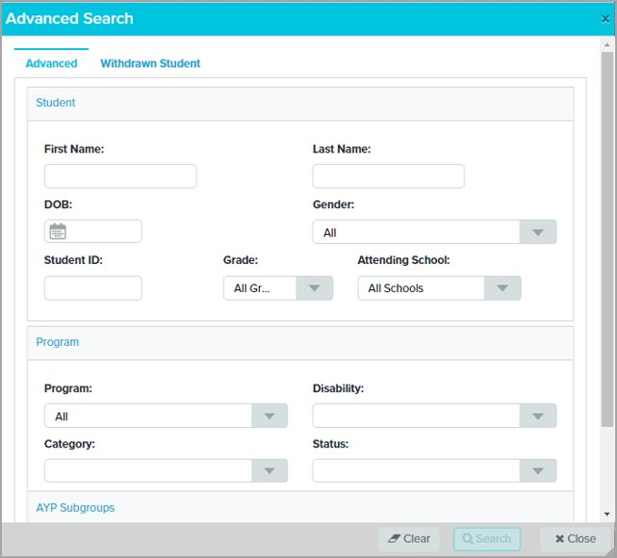
What if you can’t find a student?
Try searching withdrawn students with
Contact Student Data to ensure the student is enrolled in the correct school.
Advanced Student Search
Students can be searched using​
SSD or MOSIS ID
OR two pieces of information, for instance:
First Name, Last Name ​
SSD or MOSIS ID​
Grade and Attending School​
When 2 characters or criteria have been entered, the Search button will activate. ​
Select Search​
Notes:
Advanced Search is useful when you can’t find a student in a simple search.
In order to use Advanced Search at least two characters must be entered before the "Search" button is activated.
A search cannot be done with only the Date of Birth. Other information such as first or last name must also be entered

Slide 6
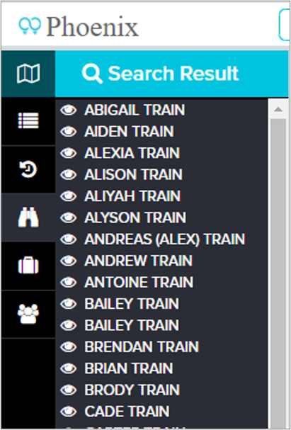
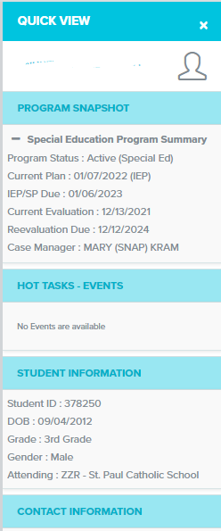
Search Results
The student list panel opens on the left.
Any time you see an eye in Phoenix you can click it for a snapshot of the student’s information.
Information varies according to where you are clicking from.
Hover over a student name to see a “hamburger” and an extra menu.

Slide 7
Notes:
Collapse/Expand: Closes and opens the panel. Closing the panel allows you to see more of the student profile, event, etc. on the right
Classlist: This option is not used by SSD
Last 10 Students: Displays the last 10 students whose profile was opened
Watch List: Students added by you or someone else. Students can be added or removed at any time. Watch Lists are automatically cleared every July 31. Students added could be the students you case manage or just need quick access to their record.
Caseload: The term "Caseload" is used differently in Phoenix than it is in SSD. In Phoenix it refers to ALL students the user is associated with in the system as Case Manager, Event Primary Staff, Service Provider, or Goal Responsible Staff. In SSD, it generally refers only to those students for whom you are the Case Manager.
Case Manager: Students you are assigned to as Case Manager in Phoenix

Slide 8
Where do you click to get back to the home screen?

Slide 9
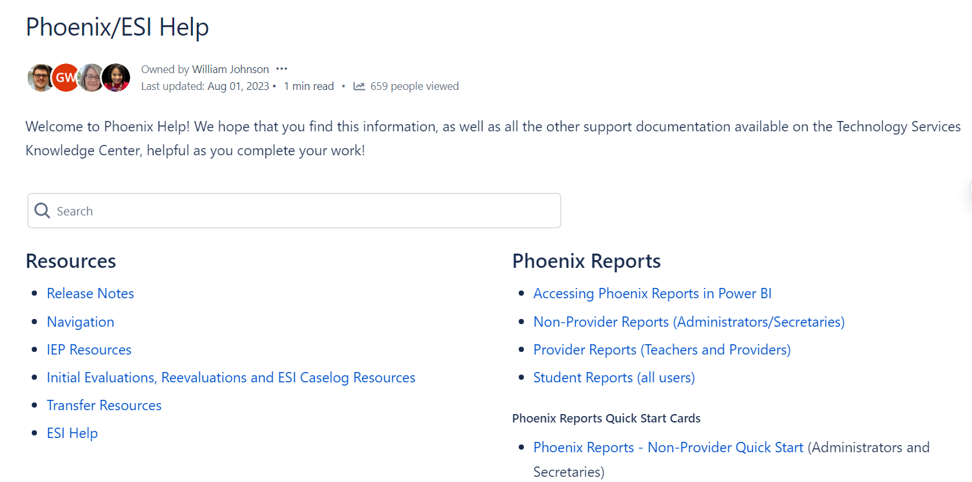
Phoenix help can be accessed from any screen.
Notes:
Resources: links to important information about Phoenix such as Release Notes and Hot Topics, Also links to page where you can download the latest versions of quick start cards, help documents, etc.
Reports: Information about accessing Phoenix reports and the different types of reports available
Training Information: Information about Phoenix training
Partner District: Information for Partner District Staff with view only access to Phoenix
Technology Service Desk: Opens the page in the SSD Help Center where a ticket requesting assistance can be created

Slide 10
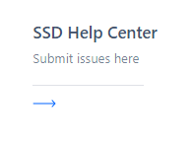
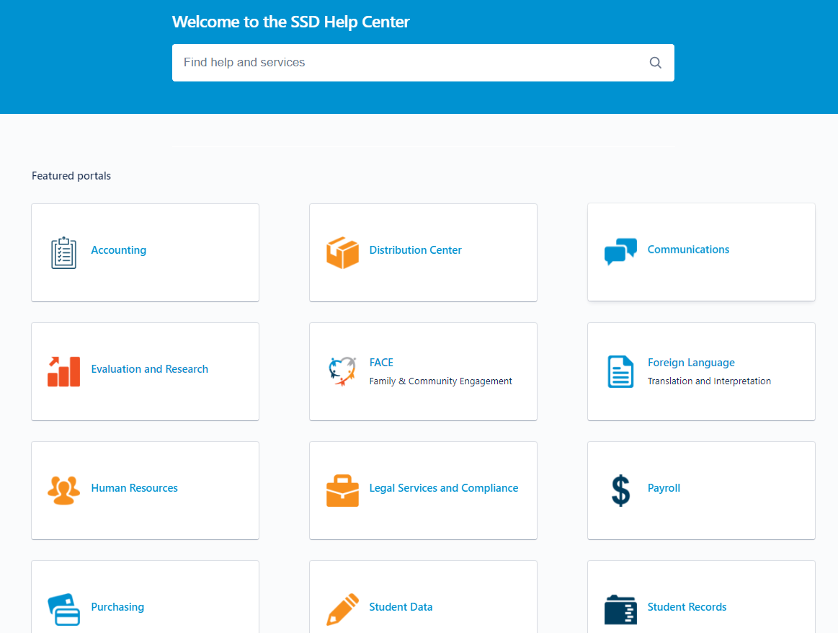

Slide 11
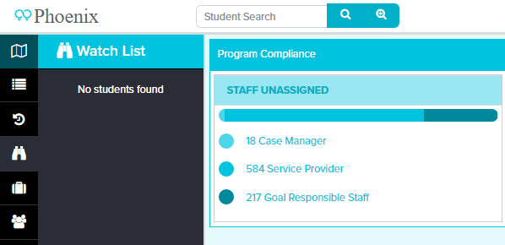
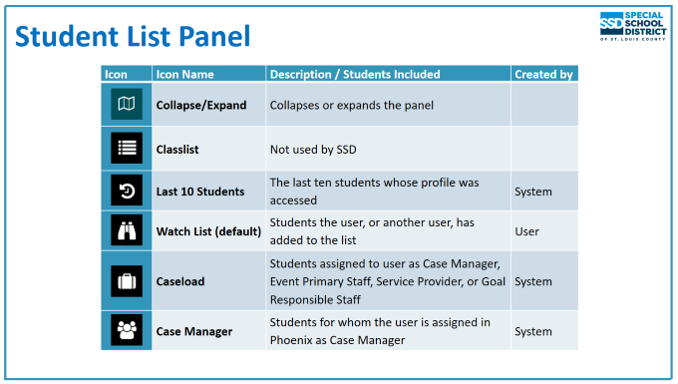
Where can you find immediate help in Phoenix?
Notes:
Collapse/Expand: Closes and opens the panel. Closing the panel allows you to see more of the student profile, event, etc. on the right
Classlist: This option is not used by SSD
Last 10 Students: Displays the last 10 students whose profile was opened
Watch List: Students added by you or someone else. Students can be added or removed at any time. Watch Lists are automatically cleared every July 31. Students added could be the students you case manage or just need quick access to their record.
Caseload: The term "Caseload" is used differently in Phoenix than it is in SSD. In Phoenix it refers to ALL students the user is associated with in the system as Case Manager, Event Primary Staff, Service Provider, or Goal Responsible Staff. In SSD, it generally refers only to those students for whom you are the Case Manager.
Case Manager: Students you are assigned to as Case Manager in Phoenix

Slide 12
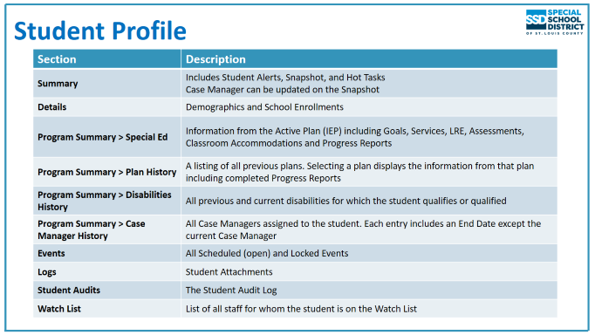
Notes:
Reminder: In the real world you only have access to students in the district(s) in which you work. In training you have county-wide access.
To search by other criteria (First and Last Name, DOB, School and Grade, etc.) select the Advanced Search icon (magnifying glass with +) which opens the Advanced Search window

Slide 13
Questions??? _______________________________________________________ Quick Review
Use the main screen, the Dashboard, for an overview of your reports and responsibilities
Use Program Summary and one of the options for an overview of a student’s plan or disabilities history or quick information about their active IEP.
You can use the filter on the upper right corner of the Dashboard to change what information you see. As Certified Staff, it is best to choose Case Manager or Caseload
The question mark in the upper right corner is available throughout Phoenix and links to general or more specific help articles

Slide 14
Notification of Meeting – Annual IEP
Notification of Meeting is linked to Annual IEP
Click the event name to open NOM
The open envelope icon indicates no notices have been created and stored

Slide 15
NOM – Event Overview
The Overview shows
Event Sections
List of forms in each Event Section
Required forms – indicated by star icon
Icons Overview – NOM Events
Icons appear at the bottom of the Overview
Back to Events: closes the event and returns you to the Events page
Invitation Record: Includes all "stored" NOM and Record of Attempt forms (only on NOM events)
Reload Event Data: Refreshes form data
Create/Store Invite: Creates a PDF of the NOM and Record of Attempts and Stores them in the Invitation Record (NOM events)
Validation Check: Checks that all required forms and fields have been completed – checks for program compliance, not DESE compliance.
A B C D E

Slide 16
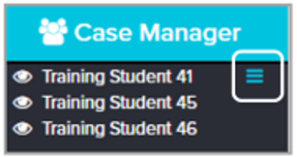
Notice of Meeting
To view form, click Notice of Meeting on Forms List panel or on the Form Name list
Review: How do you reassign student events, Case Manager, forms, or goals?
* You can also click the pencil (the tiny square) next to an event to reassign it.
Notice of Meeting – Field Colors
Colors of the fields
Red outline: Required field
Blue outline: Required field that has been completed but is editable
Grey outline: Not required, editable
Grey fill: disabled/inactive until an action is taken to turn it on

Slide 17
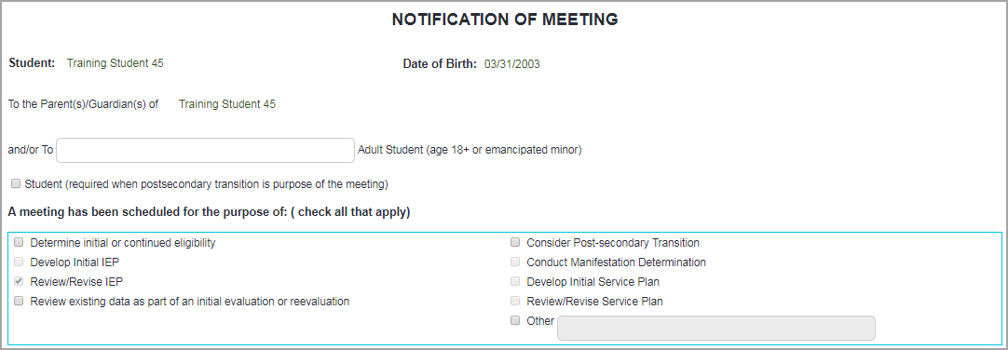
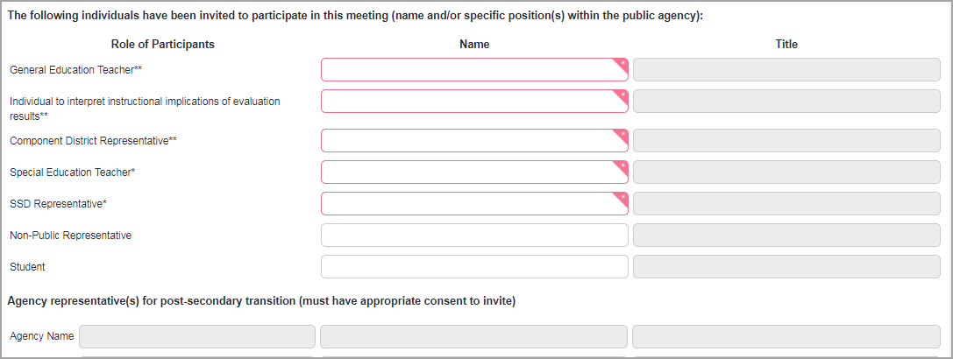
NOM – Purpose of Meeting
Select the purpose / purposes of the meeting
Can select multiple
If "Consider Post‐secondary Transition" is selected
Student Name / Title autofill in Participants section
First Agency field becomes required
Complete required fields – outlined in red
If Meeting Date is in the past a Confirmation window appears when the form is saved. Select Cancel to change the date or Proceed if date is correct.
Date Sent must be on or before the Meeting Date
It may be easiest to arrow up or down to select a different year
If the student is 15+ Transition
should be considered.
Discuss this with your Special Ed Coordinator.
Notification of Meeting ‐ Participants
Enter all participants invited by SSD
Note there are participants that may be excused
Can enter more than one name on a line
"Other" fields available
Required red outlined areas should NOT be N/A or “.”

Slide 18
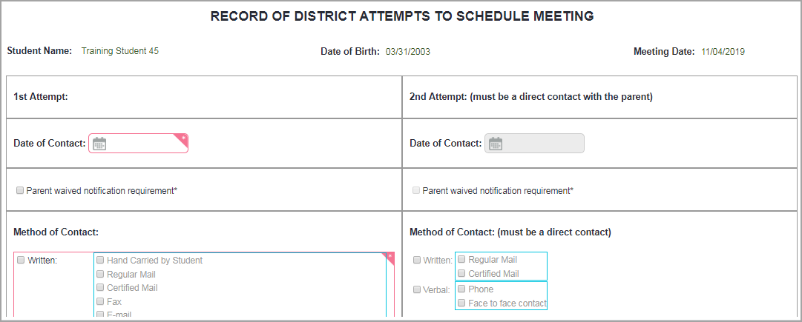
Record of Attempts
Records attempt to schedule meeting – not all contacts made
First attempt is required
Mark “yes” even if the parent hasn’t responded yet, so that you can send the notice.
Second needed only for "Cannot attend. . ." or "No response"
Click Validation Check
Message appears indicating "Validation Check Successful" or error message appears
If Validation Check is successful, continue
Form Status shows "Compliant" when Validation Check is successful
The Record of Attempts should always be updated if you reschedule the meeting.

Slide 19
Review: What should you ALWAYS do
once you’ve filled out the notice of meeting?
NOMs MUST be correct
when the event is locked.
They CANNOT be
fixed once an event
is locked

Slide 20
Notice of Meeting: Questions?
Quick Review
Red outlined boxes must be filled in.
Some fields pre-populate with information.
Solid gray box cannot be changed until another response is changed.
Gray outlined box can be changed by manually entering information.
Ensure that any demographics changes such as address/phone number are sent to Student Data.
Starred forms and red outlined boxes must be completed.
Blue outlined boxes have had information added.
If the meeting date changes, the Record of Attempts and NOM should BOTH be updated and the meeting must be created/stored again.
The Invitation Record is a permanent record of all created/stored meetings associated with a particular event.
Students 15+ should have Transition marked on the NOM and should be invited to the meeting.
The meeting invite should be sent to the parent (and student if applicable) at least 10 days prior to the meeting.
Mark “yes” on the Record of Attempts to create/store and print the NOM even if you haven’t yet heard from the parent. This response can be adjusted if the answer is “no” or “cannot attend”, when the next attempt is made.
Once the NOM is created/stored, the envelope in the events section turns black and a number appears beside it, which indicates how many times the NOM has been created/stored. The scheduled date also automatically changes to the date of the meeting.

Slide 23
DESE Top Indicators Out of Compliance (Statewide)
200.740.a: A statement of the present levels of academic achievement and functional performance: Is
consistent with evaluation/reevaluation results in the evaluation report (2)
“The evaluation report (said student was eligible for Intellectual Disability). The IEP states student (was SLD, ED and Speech Impaired).”
“There is not an evaluation report, nor is the RED finalized as to if more documentation was necessary or if the current eligibility was still appropriate.”
200.740.f: A statement of the present levels of academic achievement and functional performance: Addresses
the academic, developmental, and functional needs of the child (1)
“There is not enough detailed information about any of these areas on which to develop measurable IEP goals. There is just a statement that the student is eligible for YCDD in the areas of cognition and communication with a weakness in fine motor.”
200.810.a: The IEP includes goals that demonstrate consistency with the content of the present level of performance

Slide 24
DESE Top Indicators Out of Compliance (Statewide) (cont)
200.710.c. Child age 16+, did not attend, child’s preferences, interests considered at IEP
“Transition not mentioned.”
200.740.c How child’s disability affects involvement in gen ed curriculum – HS lens from transition
200.800.c: Transition services designed in a results-oriented process
“Parents and the school should be involved. What the student will do is all that is listed in services.”
“Services are listed as what the student only will do.”
“Services are minimal.”
“Services do not demonstrate they are a part of a coordinated set of activities.”
200.800.g: Transition services take into account child’s needs, preferences, and interests
“Services that take into account the student’s needs, preferences and interests are missing. The only services listed are what the student will do for himself.”
“Services are not specific or adequate enough to take into account needs and preferences.”
“Transition services are not supported by the IEP other than the student attending Vo-Tech automotive program.”
200.810.e. Goals are present for each special ed an related service
“No goal for Basic Reading Skills.”

Slide 25
Commonalities with DESE’s Top Indicators Out of Compliance
SSD shared 11 of DESE’s Top Indicators out of compliance, however;
SSD’s most frequent indicator found to be out of compliance:
200.800.c - Transition services designed in a results-oriented process that are a coordinated set of activities focused on improving the academic and functional achievement of the child to facilitate their movement from school to post-school activities. Services are based on the child’s needs, taking into account the child’s strengths, preferences, and interests

Slide 26
Least Restrictive Environment
LRE Mandate:
To the maximum extent appropriate, children with disabilities, including children in public or private institutions or other care facilities, are educated with children who are nondisabled; and
Special classes, separate schooling, or other removals of children with disabilities from the regular educational environment occur only if the nature or severity of the disability is such that education in regular classes with the use of supplementary aids and services cannot be achieved satisfactorily.
“Environment” may imply LRE is a place or location
LRE is broader: it’s the type of services and supports a student needs to be successful, how they are provided, in addition to where they are provided
While LRE is important, rulings indicate that whether a student receiving benefit and receiving an education appropriate to their unique needs in the placement chosen is of primary importance.
Not every student with a disability will benefit from placement in the regular education setting

Slide 27
When might placement in regular education not be appropriate?
Student will not receive a sufficient educational benefit in a regular classroom, even with the provision of supplementary aids and services.
Student's need for intensive special education services outweighs their need to interact with typically developing peers
Student engages in significantly disruptive behavior that interferes with the education of classmates.
Student is so demanding of the teacher's time and attention that they substantially interfere with the learning of others in the classroom.
Student's presence in regular education constitutes a threat to the safety of other students or poses a danger to himself.
Student will require so much modification in the curriculum that the regular program has to be altered beyond recognition, resulting in limited education value to the student.

Slide 28
Common Errors
Service minutes don’t change from IEP to the next but a PWN indicates a change
Accommodations are listed for every class but classes change at semester and accommodations don’t change
IEP/Accommodations aren’t shared/documented with new teachers, especially at secondary level
Accommodations include impossible actions for certain classes
No evidence of services provided
Progress reports aren’t issued by ALL service providers
Placement page is inconsistent with services summary

Slide 29
Predetermination
Predetermination occurs when district members of the IEP team unilaterally decide a student’s services or placement in advance of an IEP meeting.
To avoid claims of predetermination
Discuss multiple placement options and alternatives to parent’s expressed concerns
Don’t come to the meeting with an inflexible decision made on type, amount, frequency, location of services
Always discuss and explore a parent’s requests at an IEP meeting and DOCUMENT! Outright refusal to discuss a parent’s request for a particular service or placement because they aren’t the purpose of the meeting could land you in hot water. (Dekalb County Sch. Dist., 74 IDELR 299 (SEA 2019).
Actively solicit parent input in preparation for IEPs

